Slide 1
Structure of meterials
On the basis of arrangement of constituent particles, solids are classified as
1.Crystalline solids: Constituent particles(atoms or molecules)are arranged in regular repetition pattern in 3 dimensions
Eg:All metals and certain ceramics
2.Non crystalline solids or Amorphous solids: Atoms or molecules are not arranged in regular repetition pattern
Eg:Glass,Rubber,plastics

Slide 2
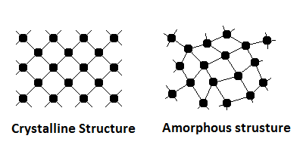
Crystalline and Amorphous solids
Amorphous
Amorphous

Slide 3
Space lattice
3 dimensional network of imaginary lines connecting atoms in a crystal
Intersection points are called lattice points which have identical surroundings
Unit Cell
The smallest portion of the space lattice which when repeated in all direction give rise to lattice structure
It is the building block of crystal structure
Bravais showed that there are 14 standard space lattices

Slide 4
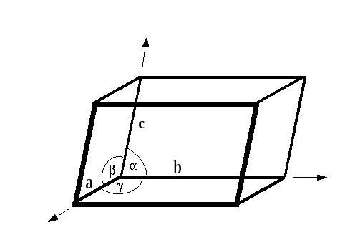
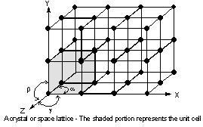
Space lattice and unit cell

Slide 5
Crystal structure of metals
1. Body centered cubic(BCC)
One atom at each corners and one at the centre of cube
At room temperature iron exhibit BCC structure
Other metals possessing this structure are V,Mo,W,Cr,Ba etc
Atomic packing factor 0.68
Coordination No: 8

Slide 6
Body Centered Cubic

Slide 7
2. Face centered cubic(FCC)
Atoms are located at corners and at the centre of each cubic face
More density packed than BCC
Metals possessing this structure are Cu,Al,Pb,Ag etc
Atomic packing factor 0.74
Coordination No: 12

Slide 8
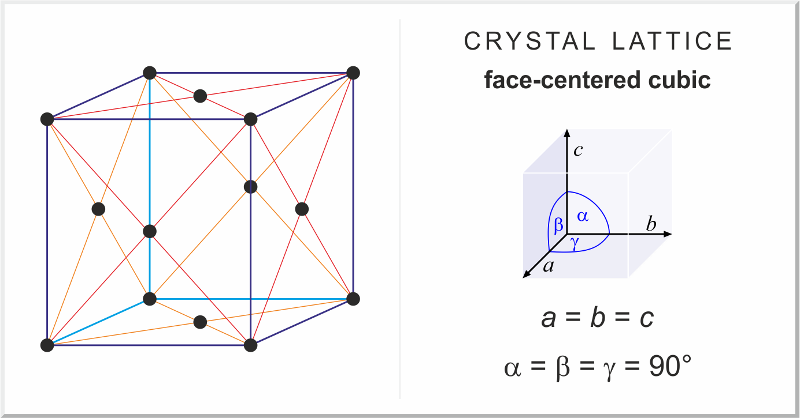
Face Centered Cubic

Slide 9
Hexagonal close packed (HCP)structure
One atom at each corner of hexagon
One atom at centre of each hexagonal face
(basal planes)
3 atoms in the form of a triangle midway between 2 basal planes
Found in metals like Mg,Be,Ca,Zn,Cd & Ti
Atomic packing factor 0.74
Coordination No: 12

Slide 10
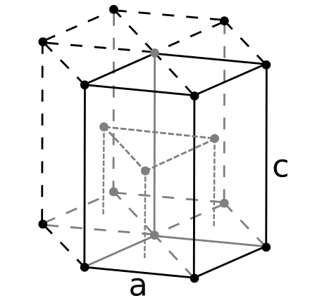
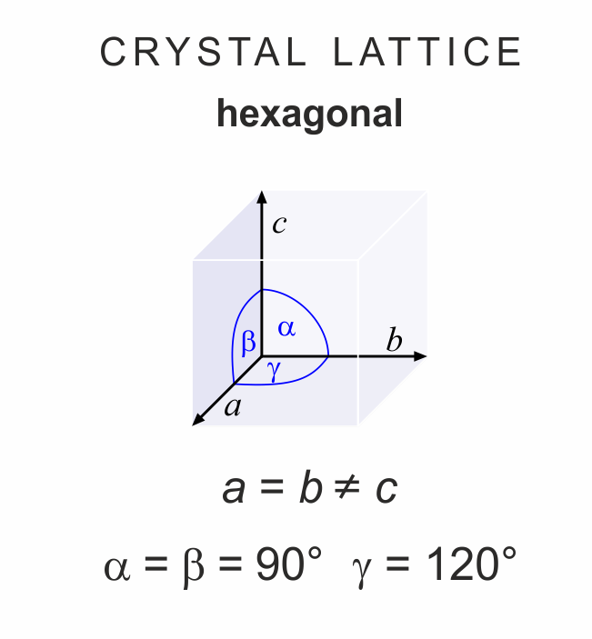
Hexagonal close packed (HCP)structure

Slide 11
Crystal growth and grain formation(Dendritic solidification)
Crystallization is the formation of crystals(grains) during phase transformation of metals from liquid to solid state
Occurs by nucleation and growth
Nucleation: Atoms of liquid bond together and form nuclei(basic crystal structure)
Growth :Nuclei grow in size with the addition of atoms
Smallest unit of repetition is called unit cell
Unit cells arrange themselves in straight lines forming primary arm.
Secondary arm branches off from primary arm and tertiary arms from secondary arm producing dendritic structure
Dendritic arms impinge each other at contact surface and forms grain boundaries
Space between the arm solidifies to form grains

Slide 12
Dendritic growth of metallic crystals from liquid sate

Slide 13
Grain size control
Following factors controls the grain size
Slow cooling results in large grains(coarse) where as fast cooling results in small grains(fine)
Metallic and non metallic inclusions
Mechanical working processes like rolling, forging etc
Alloying elements
Heat treatment process

Slide 14
Effect of grain size on properties of metals
Fine grained materials possess improved strength, resistance to impact and cracking, better finish in deep drawing .They are preferred for structural application
Coarse grained materials possess more ductility, malleability, machinability, hardenability and better creep strength .They are less tough and have greater tendency for distortion than fine grained materials. They are preferred for high temperature application

Slide 15
Grain size measurement
The grain size specified by ASTM,American society for Testing and Materials is
n = 2^{N-1}
n= No. of grains per square inch at
magnification of 100 X
N= grain size No.
Grain size no. 1 to 5 indicate coarse grained steel,6 to 10 indicates fine grained steel

Slide 16
Bonding in solids
Types of bond
Primary bond – ionic, covalent and metallic
Secondary bond (Molecular bond)
Ionic bond : Exist between a metallic and non metallic atom.Eg:NaCl
The Na atom gives away its valance electron to Cl atom producing Na + ions and Cl – ions.
Two oppositely charged ions attract and forms bonds

Slide 17
Ionic bonding

Slide 18
Covalent Bond
Electrons are shared (not transferred ) between atoms
Shared electrons are considered belonging to both atoms
Eg:In molecule of methane(CH₄) , carbon atom has 4 valence electrons where as each of the four hydrogen atom has single valence electron. So carbon and hydrogen share their electron to form covalent bond and become stable

Slide 19
Covalent bond

Slide 20
Metallic bond
Found in metals and their alloys
Metallic atoms give up their valence electron and become positive charge ions
The free electrons forms ‘electron clouds’ and are surrounded by these positive ions
Mutual force of attraction between positive ions and negative electron cloud forms metallic bond

Slide 21
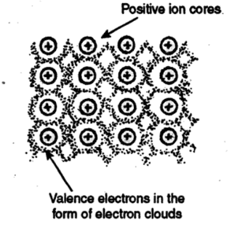
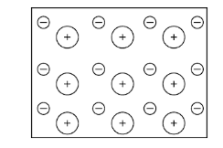
Metallic bond

Slide 22
Ionic bond | Covalent bond | Metallic bond
Higher bond strength than metallic bond | Higher bond strength than metallic bond | Lower bond strength than other primary bonds
Forms due to electrostatic force of attraction between +ve and –ve ions of different elements | Forms due to electrostatic force of attraction between atoms of same or different elements by sharing of electrons | Forms due to electrostatic force of attraction between + ve ions and –ve electron cloud of same or different metals
Low electrical and thermal conductivity | Low electrical and thermal conductivity | High electrical and thermal conductivity
High melting and boiling point | Low melting and boiling point | High melting and boiling point
Exists in solids state only | Exists in solids, liquids and gaseous form | Exists in solids only(except Hg)
Crystalline in nature | Non crystalline | Crystalline in nature
High hardness | Low hardness except diamond, silicon ,carbide | Soft
Soluble in water | Not soluble in water. Soluble in organic solvents like benzene, toluene etc. | Not soluble in water or organic solvents
Not malleable and ductile | Not malleable and ductile | Malleable and ductile

Slide 23
Secondary bond
Formed due to weak Van der Waals’ force of attraction between various atoms
3 types
Dispersion bond
Permanent dipole bond
Hydrogen bond
1. Dispersion bond
In a symmetrical molecule, centers of positive and negative charges coincide
But if the centers of positive and negative charges do not coincide, the molecule will develop a small net fluctuating charge on each end
The fluctuating charge on one molecule interact with fluctuating charge of neighboring molecule resulting in dispersion bond

Slide 24
1. Dispersion bond
Fig1:Distribution of electronic charges in helium
Fig2: Formation of dispersion bond in helium

Slide 25
2.Permanent dipole bond(Dipole-dipole bond)
Due to unequal sharing of electrons between two atoms, opposite charges will be created and permanent dipole is produced
Such dipoles attract each other and forms dipole- dipole bond
E.g.: Even though hydrogen fluoride molecule is formed by covalent bond there is an electrical imbalance because the shared electrons are more close to nucleus of fluorine atom than nucleus of hydrogen atom
This way an electrical dipole is created. Dipoles of opposite charges attract each other forming permanent dipole bond

Slide 26
2.Permanent dipole bond(Dipole-dipole bond)

Slide 27
3.Hydrogen bond
Special type of dipole bond
Produced when hydrogen atom of one molecule is attracted to highly electro negative atoms(F,O,N)
Eg:In H₂O,the hydrogen electrons are more attracted towards oxygen atom (oxygen atom is more electro negative than hydrogen) inducing small +ve charge on hydrogen atom and small –ve charge on oxygen atom and thus creating a dipole leading to bonding

Slide 28
Hydrogen bond

Slide 29
Crystal defects(Crystal imperfection)
In ideal crystal atoms are arranged in regular way
In actual cases the arrangement of atoms are disrupted
These disruption is known as crystal defects or imperfections

Slide 30
Classification of crystal defects
Point defect or zero dimensional defect
They are imperfect point like region in a crystal
Various point defects are
Vacancy
An atom missing from regular lattice position
b. Self interstitial
When an extra atom within the crystal occupies a space between regularly positioned atoms in a crystal

Slide 31
c.Substitutional and interstitial impurity
Impurity is the presence of foreign atoms in a crystal
Substitutional:When impurity atom occupies the void space where regular atoms are missing
Interstitial :A small sized impurity atom occupying void space with out disturbing parent atom from their regular sites

Slide 32
Point defects

Slide 33
Frenkal defect:
Combination of vacancy and interstitial defect
An ion displaced from normal lattice site to interstitial site
Cations(+ ve ion) being smaller than anion(- ve charge) is displaced to void space
Schottky defect:
A pair of cations and anions missing from lattice site of an ionic crystal
Closely related to vacancy
*Frenkal and shottky defects are found in ionic crystals

Slide 34
Schottky and Frenkel defect

Slide 35
2.Line defects or dislocations
One dimensional defects
Disturbed region between two perfect part of a crystal
Responsible for slip by which metal deforms plastically
Two types
1. Edge dislocation
2.Screw dislocation

Slide 36
Edge dislocation:
An extra half plane of atoms either above or below the slip planes
Magnitude and direction of dislocation is expressed in terms of Burgers vector
The vector is at right angle to edge dislocation
It is determined by drawing a rectangle in the region under consideration by connecting equal no. of atoms on opposite side and if certain region contains an edge dislocation, the circuit will break

Slide 37
Edge dislocation

Slide 38
Edge dislocation - Burger’s circuit

Slide 39
2.Screw dislocation
Shear stress applied on the crystal causes a portion of crystal to be shifted relative to other
Arrangement of atoms appears like screw.so it is called screw dislocation
Burgers vector is parallel to line dislocation

Slide 40
Screw dislocation - Burger’s circuit

Slide 41
3.Surface defects
2 dimensional in nature
3 types
Grain boundaries
The region that separates two adjacent grains of different orientation in a polycrystalline material
At the grain boundaries atoms are not arranged perfectly and hence disturbed region is formed
When orientation difference between neighbouring grains are more than 10°–15° are called high angle grain boundaries
Orientation difference is less than 10° are called low angle grain boundaries or tilt boundaries
Tilt boundary is composed of edge dislocation lying one over the other

Slide 42
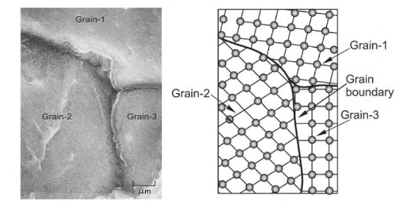
Grain boundary

Slide 43
2.Tilt boundary

Slide 44
3.Twin boundary
Produced due to mechanical shearing forces and annealing heat treatment
The arrangement of atoms on one side of the boundary is mirror image of that of the other side

Slide 45
Miscellaneous defect-Stacking fault
Formed when atoms are arranged in a sequence other than normal sequence
Occurs in FCC when there is interruption in ABCABCABC… stacking sequence
Occurs in HCP when there is interruption in ABABAB… stacking sequence

Slide 46
Staking fault

Slide 47
Volume defect
These include pores, cracks, foreign inclusions etc.
Introduced during processing and fabrication

Slide 48
Mechanism of plastic deformation in metals
Plastic deformation of metals occurs by slip and twinning
1.Slip
Permanent deformation of one part of crystal relative to the other.
Slip involves sliding of one plane of atoms over the other under the influence of shear force.
2.Twinning
Atoms of a part of crystal when subjected to stress are displaced so that the twinned portion of the crystal is a mirror image of the parent crystal

Slide 49
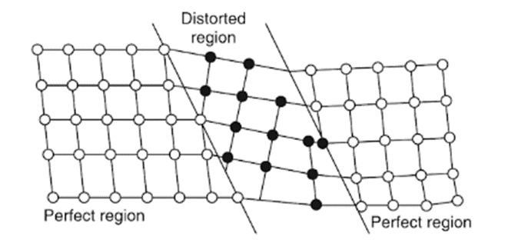
SLIP AND TWINNING
Twinning
Slip process

Slide 50
Property changes by deformation- work hardening, solid solution hardening, and precipitation hardening
Work hardening or Strain hardening
Process of making metal stronger through plastic deformation by cold working
Used for metals which are least responsive to heat treatment
Plastic deformation is caused by dislocation movement
When material is cold worked, there will be an increase in dislocations which will interact with other moving dislocations
The interacting dislocations lead to decrease in their mobility (*similar to traffic jam) and hence material get strengthened
Work hardening reduces ductility and plasticity

Slide 51
Principle of work hardening
When loaded , the strain increase with stress and curve reaches point A in plastic range.
If at this stage , the specimen is unloaded , the strain does not recover along the original path AO , but moves along AB .
If the specimen is reloaded immediately , the curve again rises from B to A ,but via another path , and reaches the point C , after which it will follow the curvature , if loading is continued .
If the specimen would not have been unloaded , after point A , the stress–strain curve would have followed the dotted path AD’ .
Comparing paths ACD and AD’ shows that the cold working (plastic deformation) has increased the yield strength and ultimate strength of the metal .

Slide 52
Principle of work hardening

Slide 53
2. Solid solution hardening
Strengthening and hardening of metals by alloying with impurity atoms to form substitutional or interstitial solid solution.
Solute atom will be smaller or larger than solvent atom
Due to difference in atomic size there will be lattice distortion when one element is added to other
Smaller atom will produce tensile strain field and larger atom will produce compressive strain field in the crystal
In both cases strain field of solute atoms interact with strain field of moving dislocations
This increases the force needed to move the dislocation and thus the strength get increased
Eg: Carbon (solute) in iron (solvent) to form steel (interstitial solid solution)

Slide 54
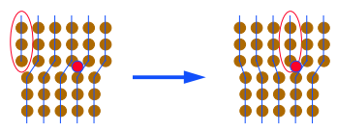
2. Solid solution hardening
Representation of a dislocation Stopped by a substitutional atom
Representation of a dislocation stopped by an interstitial atom

Slide 55
3.Precipitation hardening or Age hardening
Strengthening by precipitation of fine particles of second phase from supersaturated solid solution
The secondary phase precipitates with age i.e. with passage of time
For example: Certain alloys such as Al- 4.5% Cu shows increase in hardness with age

Slide 56
Age hardening procedure
Heat treatment:Solutionizing or heating to single phase region
Quenching rapidly to form supersaturated solid solution
Ageing at or above room temperature, second phase (eg:CuAl₂) precipitates, which hinder the dislocation movement and result in strengthening

