Slide 1
MODULE III
CURE CHARACTERISTICS AND VULCANISATION METHODS
Course Outcome:
To understand the cure characteristics ,cure measurements and different vulcanisation methods

Slide 2
3.1.0. To understand the cure characteristics ,cure measurements and different vulcanisation methods
3.1.1. Define scorch and scorch time, cure and cure time, optimum cure, state of cure, cure index, delayed action.
3.1.2. State the methods for avoiding scorch.
3.1.3. Illustrate cure graph of mooney viscometer and rheometer.
3.1.4. Explain the various cure graphs by changing different type of accelerators and curing agents.
3.1.5. Describe the procedure for the determination of cure characteristics.
3.1.6. Define viscosity, elasticity and plasticity.
3.1.7. Describe different basic processing steps for product manufacture using NR and SR.
3.1.8. Explain different heating medium, mention their merits and demerits.
3.1.9. Define moulding, and state compression moulding, transfer moulding and injection moulding.
3.1.10. State vulcanisation methods other than moulding.
3.1.11. Explain different batch curing methods.
3.1.12. Describe continuous vulcanisation methods such as fluidised bed, microwave, rotocure, steam tube curing, molten salt bath with suitable examples.

Slide 3
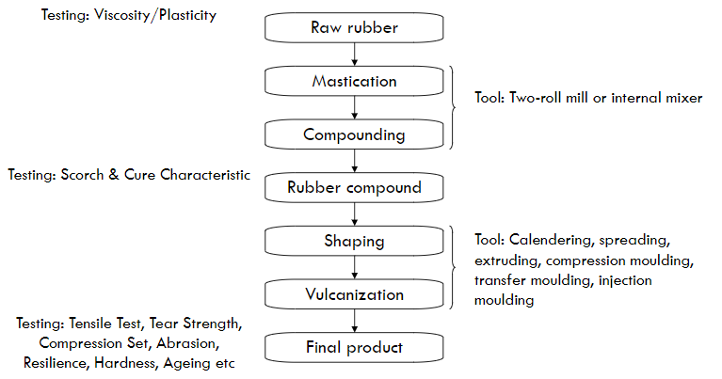
RAW RUBBER PROCESSING

Slide 4
CURING
Curing is a process whereby chemical crosslinks are created between the chains of rubber molecules, resulting in the formation of a three-dimensional network.
Reaction proceeds under elevated temperature and pressure to form elastic material
Choice of accelerator in the process of sulphur vulcanization determines the kind of network structure and consequently leads to the specific material properties

Slide 5
TERMINOLOGIES RELATED TO CURE CURVES
Scorch - premature vulcanization in which the rubber compound becomes partly vulcanized before the product is in its final form and ready for vulcanization.
Reduces the plastic properties of the compound so that it can no longer be processed.
The period of time before vulcanization starts is referred to as “scorch time.”
Delayed Action Cure - uses an accelerator or combination of accelerators or a retarder that could delay the reactions which cause the formation of crosslinks, and thus prolong the scorch time of the compound.

Slide 6
TERMINOLOGIES RELATED TO CURE CURVES
State of cure - used to indicate the development of a property of the rubber compound as the cure progresses.
As crosslinks formed, the vulcanized compound becomes tighter and the forces (stress) necessary to achieve a given deformation increase.
Technically, the most important state of cure is the so-called “optimum state of cure” , where the predominant properties of cured rubber are formed
Under cure compound - State of vulcanization less than the optimum state of cure. This is evidenced by tackiness or inferior physical properties of the vulcanizates such as inferior tensile strength, inferior modulus, inferior compression set.

Slide 7
TERMINOLOGIES RELATED TO CURE CURVES
Overcure -
If overcuring (continued heating) of the rubber occurs, a stiffening (marching modulus), or softening (reversion), of the compound can be the result.
Affects reduce physical and adhesion properties of the rubber compound.
Marching - rubber compound continues to harden, the modulus rises, and tensile and elongation fall.
Reversion - modulus and tensile strength decrease.
Cure Time - time required by the sample to reach a desired state of cure, usually to reach 90% of the maximum cure.

Slide 8
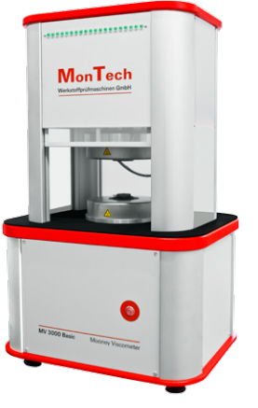
MOONEY VISCOMETER / SHEARING DISC VISCOMETER
To measure the plasticity or viscosity of rubber and their compounds
Viscosity of rubber or compound plays vital role in deciding its processing behaviour
Rubber compound have to undergo various processing before it can be vulcanized into its final form.
Deviation in viscosity of the compound will critically alter its processibility specially in terms of calendaring, extruding or injection moulding. It is necessary that viscosity parameter be maintained within specified limits
To assess the scorch time and or cure time of a rubber compound
Able to predict behaviour of rubber compound with respect to temperature and time during processing

Slide 9
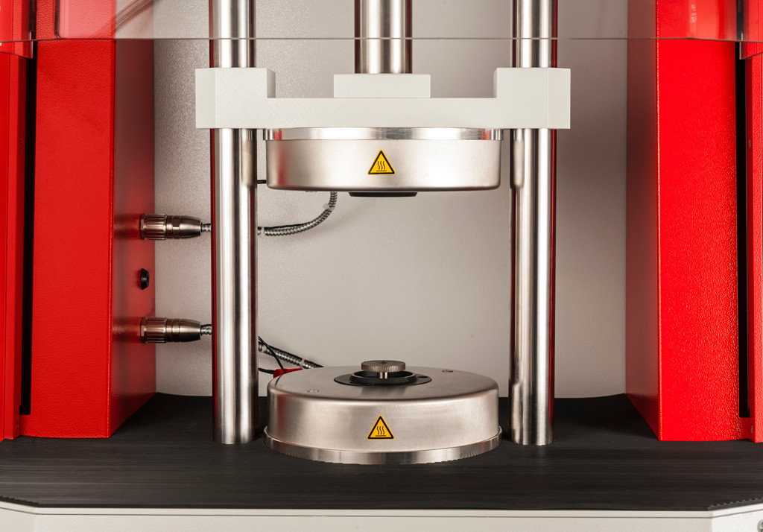
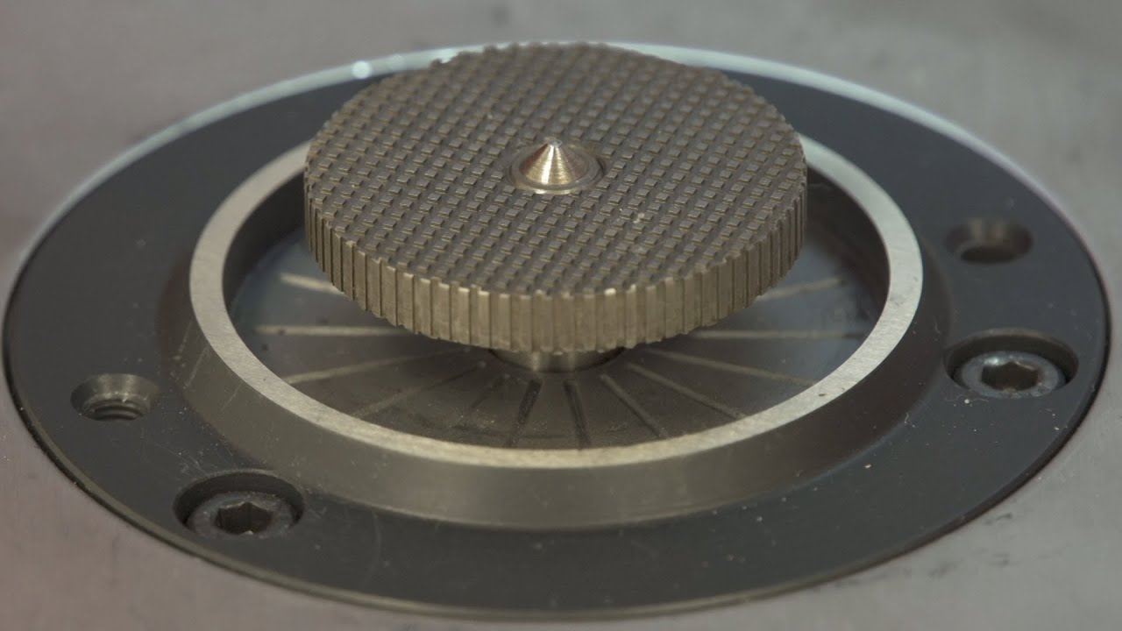
MOONEY VISCOMETER / SHEARING DISC VISCOMETER
Developed by Dr. Melvin Mooney of U.S Rubber Company in 1930
Standards : ASTM D 1646 , ISO 289
Consists of a rotating serrated motor driven rotor embedded in a rubber specimen, contained within a sealed, pressurized cavity.
Rotor ((S/L) is rotated at 2 revolutions/minute
Temperature of cavity is adjusted, usually a preheat time given after closing the dies to allow the rubber to approach the set temperature of the instrument
As rotor rotates , shearing action develops between compound and rotor
Resistance to rotation is detected by a load cell (torque) is measured and torque is converted into Mooney units.

Slide 10
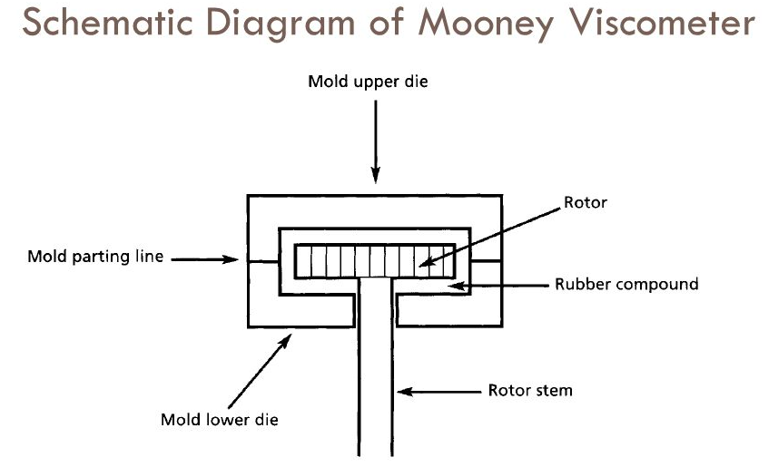
WORKING OF MOONEY VISCOMETER
Mooney viscosity is defined as the shearing torque resisting rotation of a cylindrical metal disk (or rotor) embedded in rubber within a cylindrical cavity ( low shear rate 1.3 s ⁻¹ )
Test procedure
Rotors are placed within the closed dies allow them to attain the test temperature.
Adjust the torque indicator to a zero reading while the viscometer is running unloaded with the rotor in place. Then stop the rotation of the disk
Remove the hot rotor from the cavity and quickly insert the stem through the centre of one of the test pieces, and replace the rotor in the viscometer.
Place the second test piece on the centre of the rotor, close the dies immediately, and activate the timer.
Warm the specimen in the closed Mooney viscometer test cavity for exactly 1 min.
Start the motor which drives the rotor.
The time to reach an equilibrium reading after the start of the motor is also recorded.

Slide 11
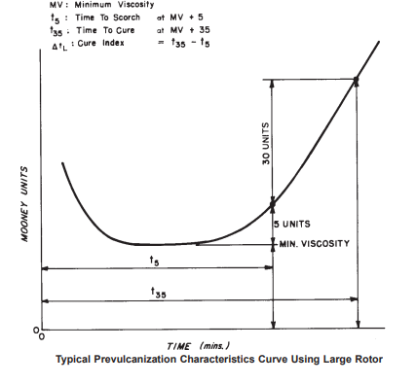
EXPRESSING TEST REPORT IN MOONEY VISCOMETER
A typical test result would be reported as follows:
50 − ML 1 + 4(100°C)
where 50− is the viscosity number
M - Mooney
L - larger rotor (S would indicate the small rotor)
1 - pre-heat time in minutes, after the cavity is closed but before the rotor is switched on, during which the rubber warms up to the cavity temperature
4 - time in minutes after starting the motor at which the reading is taken
100°C - test temperature
Scorch time : time required for 3 or 5units above the minimum viscosity (t₃ / t₅)
Cure time : time required for 18 or 35 units above the minimum viscosity (t₁₈/ t₃₅ )

Slide 12
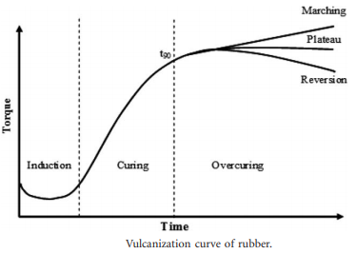
CUREMETERS
Main types of equipment used for producing vulcanization curves are
Oscillating disk rheometer (ODR)
Moving die rheometer (MDR)
Piece of rubber compound is contained in a sealed test cavity with a rotor that oscillated at a constant angular displacement.
As vulcanization proceeds at a specific temperature, the torque required to shear the compound is monitored and a curve of torque versus time can be generated.
As the stiffness of the rubber compound increases with the formation of the crosslinks during vulcanization.
Curemeters

Slide 13
Induction period
Slow chemical reaction between rubber and the additives.
Curing
Curing of rubber molecular chains occur to form network structures.
Overcuring
Involve over curing reactions depending on the rubber type, vulcanization agent and temperature.
Enables safe processing and good flow of the rubber compound inside a mould cavity
Optimum cure time (t₉₀) is the time required for the torque to reach 90% of the maximum achievable torque (T90) and relates to the time necessary for the cured rubber to achieve optimal properties
In an ideal case, an equilibrium degree of vulcanization is obtained and the torque versus time graph plateaus.
Reversion due to overheating during the test that corresponds to break down of rubber networks.
Additional crosslinks may occur (induced by reaction of very reactive vulcanization agent such as hyperoxides) to produce a marching curve.

Slide 14
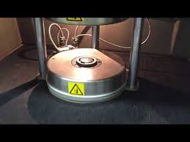
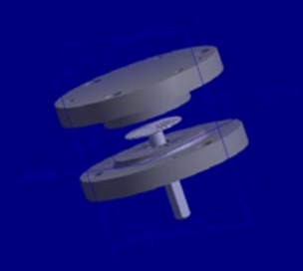
OSCILLATING DISC RHEOMETER
Introduced in 1963
ODR – used to determine the kinetics of crosslinking i.e. monitors curing as well as processing characteristics of the compound
“Cure Curve” obtained with a Rheometer is a finger print of the compound’s vulcanization and processing character

Slide 15
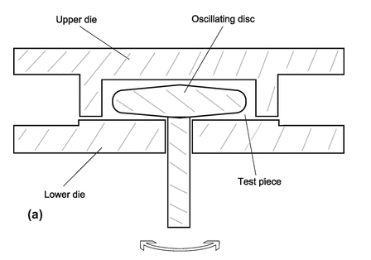
OSCILLATING DISC RHEOMETER
Consisting of an oscillating disc, enclosed in an unsealed, stationary cavity.
Disc oscillates at a fixed frequency and amplitude (1° or 3°) and operates in the same range of temperatures and pressure as the Mooney viscometer.
Test specimen of vulcanizable rubber compound is inserted into the cure meter test cavity and after a closure action forms a sealed cavity under positive pressure.
Cavity maintained at elevated vulcanization temperature.
Rubber totally surrounds a biconical disk after the dies are closed.
Oscillation of disc exerts a shear strain on the test specimen.
Force required to oscillate or rotate the disk to maximum amplitude is continuously recorded as a function of time, with the force being proportional to the shear modulus (stiffness) of the test specimen at the test temperature.

Slide 16
WORKING OF OSCILLATING DISC RHEOMETER
Test Procedure
The standard test temperature shall be 160°C.
Bring the temperature of both dies to the temperature of test with the disk in place and the dies in the closed position. Set the running time and torque level
Open the dies, place the test specimen on top of the disk and close the dies. This operation must be completed within 20 s.
Start the recorder at the instant the dies are closed
The disk may be oscillating at zero time or oscillation may be started not later than 1 min after the dies are closed.

Slide 17
EXPRESSING TEST REPORT OF ODR
Test Report
The test results are usually reported with M_{H} = Maximum torque and M_{L} = Minimum torque values. The Scorch time is reported as follows:
t_{S}1 is equal to the time to 1 dN·m rise above ML; is used with 1° amplitude.
t_{S}2 is equal to the time to 2 dN·m rise above ML; is used with 3° (and 5°) amplitudes.
Cure time is reported as tc90.
tc90 = Cure time at which 90% of cure has taken place that is the time for the torque to increase from the beginning of the test to the value, equivalent to 0.9(M_{H} − M_{L})+M_{L}

Slide 18
Vulcanization – Different methods
Moulding
( Shaping and curing
within the mould)
Methods other than moulding
(Curing of previously shaped compound/composites)
Batch curing Continuous curing
Autoclave or steam pan • High pressure steam tube
Hot air oven • Hot air tunnel
Water curing • Fluidized bed
Lead curing • Liquid curing method
• Continuous drum cure
• Microwave vulcanization
Compression moulding
Transfer moulding
Injection moulding
Blow moulding
Vacuum moulding

Slide 19
MOULDING
Introducing uncured elastomer into a heated mould, high pressure applied
Stock softens with heat and flows under pressure, filling the cavities
On prolonged heating , material converts from thermoplastic stage to elastic stage
Removed from mould even when still hot
Compression moulding
Transfer moulding
Injection moulding
Blow moulding
Vacuum moulding
Moulding
( Shaping and curing
within the mould)

Slide 20
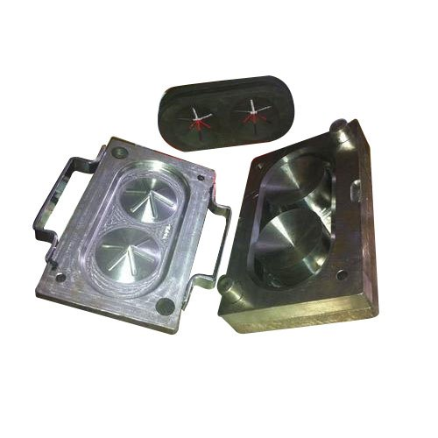
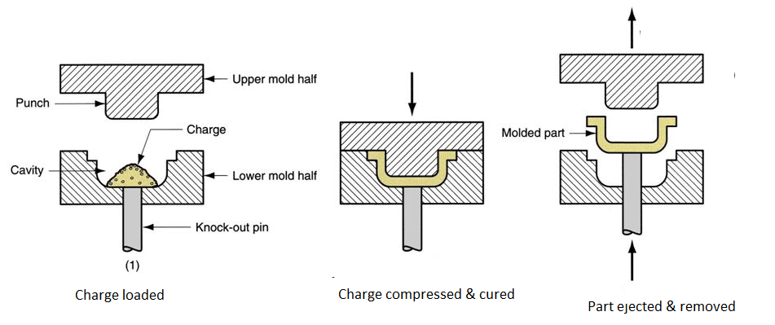
COMPRESSION MOULDING
Charge is placed in the cavity of matched mould in open position
Mould is closed by bringing the two halves together
Pressure is exerted to squeeze the compound so that it fills the mould cavity
While under pressure, compound gets cured and attains the shape of the cavity
Excess material is forced into the overflow channels

Slide 21
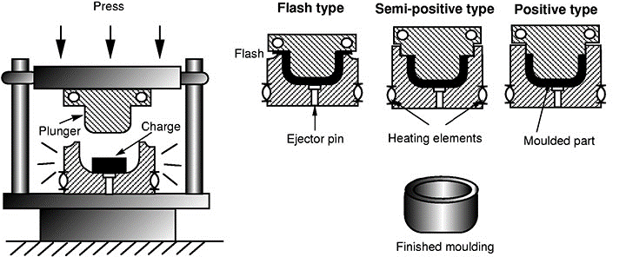
Compression mould
Straight flash type
Semi positive type
Positive or plunger type

Slide 22
Flash type
Excess of uncured stock in the cavity
Least expensive
Positive type
Full load of the press is applied directly on the rubber during moulding & curing
Semi positive type
Compromise between flash type and positive type
Better heat transfer than other types
Used for relatively simple shapes
Used for moulding extremely soft and hard compounds
Exact quantity of material must be placed in the mould
Low heat transfer since top plate is insulated from the mould by an air space, except for the area in contact with the plunger

Slide 23
ADVANTAGES AND DISADVANTAGES OF COMPRESSION MOULDING
Advantages | Disadvantages
Good for small production runs Lower cost Tooling: made of aluminium or lower cost grades of steel to reduce costs must be capable of withstanding the considerable moulding pressures required. Good for large parts No gates, sprues or runners | Greater waste Slower process times Not suitable for complex moulds Higher labour cost Moulds can be damage
Applications : Moulding gaskets, seals, O-rings, and large bulky parts etc.

Slide 24
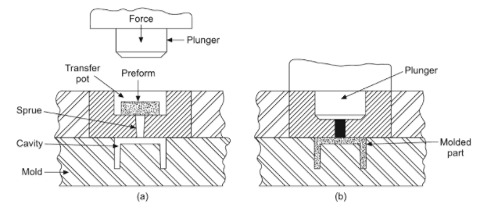
TRANSFER MOULDING
Involves transfer of uncured elastomer from one place to another within the mould
Mould is closed with the cavities empty
Stock is placed in a recess called POT on top of mould
Pot is fitted with a ram or piston which is inserted over the stock
Pressure is applied to ram, soften stock flows through sprue ,runners and gates into the mould
Vulcanization takes place to get the desired shape
Mould opened, product removed
Sprues, runners are discarded as scarp

Slide 25
ADVANTAGES AND DISADVANTAGES OF TRANSFER MOULDING
Advantages | Disadvantages
Easy to mould complex shapes Good dimensional tolerance control No pre-shaping for complex shapes Volume of stock need not accurately be weighed Minimum air trapping Minimum de-flashing Shorter curing cycles and uniform state of cure Metal-rubber bonded products are easily moulded ensuring good bonding | Greater waste Use of complex moulds since the design and mould tends to be complex, tooling can also become expensive Cleaning the tool can be time consuming and sometimes special equipment like dry ice blasters are used to clean the intricate transfer insert

Slide 26
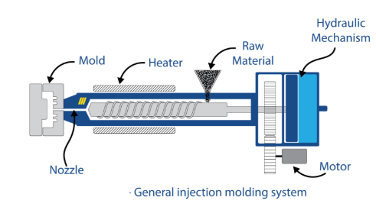
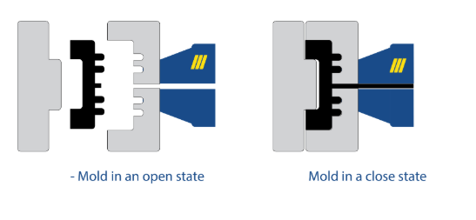
RUBBER INJECTION MOULDING
Uncured rubber in a measured amount is injected into the moulding machine through a nozzle.
Rubber transferred into a heated barrel while keeping the constant pressure.
The heated material is injected into a heated chamber which is formed by the mould.
The material flows to fill in the cavities through a runner and gate system under high pressure and elevated temperature to activate the
At the end of curing the mould is opened (manually or automatically) and the parts are removed
The parts are cleaned and optimised for use.

Slide 27
ADVANTAGES AND DISADVANTAGES OF RUBBER INJECTION MOULDING
Advantages
Shorter Production Times
Disadvantages
The tooling can be expensive compared to compression or transfer moulds.
“pre-forms” not required, reducing prep time and labour costs.
Curing process begins as the rubber is forced into the mould.
May have flashless tooling to reduce post curing operations.
Minimal material waste.
Effective for very high-volume parts.
Small runs may be costly due to the setup times.
Some part design restrictions such as wall thicknesses.
Material restricted to high flowing/low viscous compounds.
Tool modification often difficult.

Slide 28
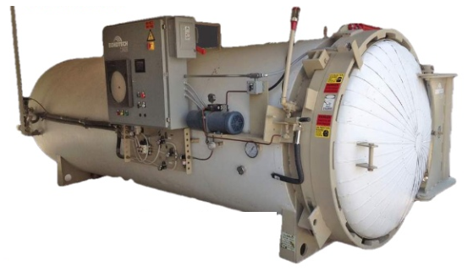
AUTOCLAVE/STEAM PAN CURING
BATCH CURING
Cylindrical pressure vessels with lids or doors in which rubber can be cured at elevated pressure and temperature.
Temperature and pressure for cure achieved by the use of steam
Extrusions, sheeting's, and other items which are unsuitable for mold curing
Large number of components can be cured at a time

Slide 29
AUTOCLAVE/STEAM PAN CURING
JACKETED AUTOCLAVE
Consists of two large vessels , one inside the other
Inner vessel filled with N₂ atmosphere, outer vessel with higher pressure steam to provide heating
Curing in inert atmosphere eliminates chances of oxidation
Produces bright colored items
UNJACKETED AUTOCLAVE
Admits steam directly in the chamber
Steam condenses on the walls of chamber and on the surface of rubber product leaving behind a mark on the product
Chance of partial degradation

Slide 30
AUTOCLAVE/STEAM PAN CURING
After loading the autoclave with the components, it is closed
Steam is then very rapidly applied and vulcanisation completed for the prescribed cycle
The pan is then cooled under pressure, otherwise blistering of the product may occur
Bulky components usually require a "stepped cure" which involves raising the auto clave temperature to the maximum vulcanisation temperature through a series of steps to give a relatively uniform temperature distribution through the product during heating
This technique is used when bulky mouldings are given a second cure in the autoclave after being vulcanised to the point of dimensional stability in the mould

Slide 31
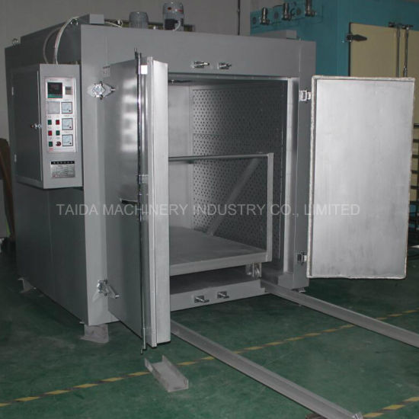
HOT AIR OVEN CURING
BATCH CURING
Mainly used for post curing of heat resistant polymers like silicone and fluorocarbon
The hot air post cure serves two purposes.
Continue the crosslinking process to improve the physical properties of the rubber product
Drive off volatile materials from components intended for service at high temperature by raising them above their service temperature.
Toxic fumes are disposed should be vented directly to the atmosphere and to ensure that fumes do not re-enter any of the work areas.

Slide 32
WATER CURING
Employs an autoclave as a pressure vessel, heating being either from a steam jacked or from steam injection
Autoclave is first loaded with the components, then filled with cold water
Steam is then applied and vulcanisation is completed for the prescribed period
This method curing finds application in the vulcanisation of very large hand build rubber lined machinery such as pumps, pipes and chemical tanks
The water supplies the pressure for adequate adhesion of the rubber to metal in addition to acting as the heat transfer medium
SULPHUR CHLORIDE CURING
Thin walled rubber articles can be cured by dipping in the solution of sulphur chloride in carbon di sulphide or exposure to its vapours

Slide 33
LEAD CURING
Moulded length hose is cured by this technique, involves the formation of a lead sheath around the hose
Sheath of lead is made to surround the cover of the hose by passing through a lead extruder.
Lead-sheathed hose is next wound on to a large drum
Lining of the hose is now filled with water, pressure applied and the ends of the hose and leads are clamped
Drum and contents are placed in large vulcanising pans (steam autoclaves) and curing is carried out.
Water inside the hose expands and becomes superheated.
Hose is pressed against the lead which not as a mould and hence the name of the process.
After cure and cooling, the clamps are out from the hose by slitting along its length in a stripping machine.
The cured hose is coiled up, tested and inspected

Slide 34
CONTINUOUS CURING
HIGH PRESSURE STEAM TUBE CURING
Suitable for cables and hoses.
Cable or hose being pulled through a long pipe which is filled with a flow of high pressure steam at a pressure of 15 kg/cm² or higher
One end of the steam pipe is connected to an extruder and the other end is sealed with rubber or water seals to retain the steam pressure.
The steam tube is normally approximately 75 m long.
Depending on the thickness of the cover, the period of time in the tube can be controlled to complete vulcanization, or conversely, the length of the steam tube can be extended. The production rate is normally between 10 - 120 m/min. This corresponds to a curing time of 0.5 - 6 min if the steam pipe is 60 m long.

Slide 35
MOLTEN SALT BATH OR LIQUID CURING METHODS (L.C.M.)
The extruded compound goes through a long basin via a short conveyer belt down into a tank filled with hot molten salt amalgamation.
Length, width and depth of the tank varies depending on the size of the products to be manufactured
Any salt adhering the extrudate is removed by washing in water
The greatest advantage of this method is that the salt provides very fast heat transmission to the products to be manufactured.
Disadvantages are the negative environmental aspects of the process.
Salt Mixture
Sodium nitrite - 40 %
Potassium nitrate - 53%
Sodium nitrate - 7 %
Heated at
150 -250 °C

Slide 36
FLUIDISED BED CURING
A metal chamber containing glass beads(0.1-0.2mm) with perforation at the bottom
Glass beads are heated initially by steam and compressed air replaces steam once the temperature is attained
Glass beads thus get suspended and separated from each other; behaves just like a fluid
Heat is transferred by convection to the objects
The product to be vulcanised floats near the surface of the bed and cure takes place in a short time.
Venting is essential to remove any trapped fumes to the atmosphere
Temperature of the air is approximately 220 °C
Disadvantage
Glass beads can easily stick to certain soft materials, cleaning of the product is needed

Slide 37
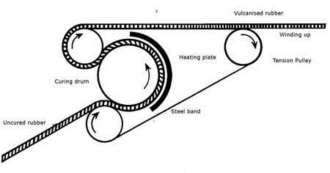
ROTOCURE
Consists of a large, steam heated, revolving steel drum and a tension steel belt which holds the sheet around the circumference of the drum
Drum dia-600 –3000mm, pressure 450 –1500 Pa
Steel belt imparts good surface finish to the product
Drum is heated by using steam to a temperature of 150 - 200 °C.
Heating plate bent round approximately half of the surface of the drum gives some additional heat, but primarily it prevents loss of heat.
Calendared rubber material is placed between the drum and the band at the lower conducting roller.
Slow rotation of the drum permits vulcanization to occur after approximately 10 minutes contact time.
Applications : Sheeting , flooring, belting

Slide 38
MICROWAVE CURING
Microwave - form of electromagnetic energy defined within the frequency range 300 - 300,000 MHz ; wave length between 1mm and 30 cm
Ultra high frequencies of 915 -2450 MHz is used (good penetration depth)
Process requires polar rubber mixtures since nonpolar materials will not absorb the energy produced
Non polar rubbers are made polar by incorporating polar ingredients ( CB or polar rubbers)
Microwave units designed to accept extrudates

Slide 39
MICROWAVE CURING
Magnetrons (located in a tunnel) generates microwaves which couples directly with the polar molecules
Provides uniform & rapid heating
Heat energy is produced within the bulk of the rubber and it is driven to its surface.
Teflon, polyethylene or polypropylene are normally used as materials in microwave chemical reactors.
Microwave vulcanisation units consist of a microwave section followed by a hot air section, the function of the latter section is to maintain the temperature established by microwave heating.
Rubber profile passes through a conveyor belt inside the tunnel , where actual curing process.
Air temperature in the tunnel is over 200 °C, It is possible to warm articles up to 200°C within 30 seconds

