Slide 1
PLASTERING

Slide 2
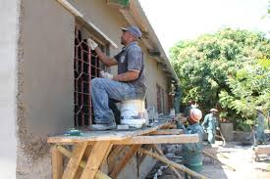
Process of covering rough walls and uneven surfaces of a building with a plastic material to form a durable surface.
Plastic material-mixture of cement, sand & water

Slide 3
TYPES OF PLASTERING
CEMENT PLASTERING
LIME PLASTERING
MUD PLASTERING
WATERPROOF PLASTERING

Slide 4
OBJECTIVES
Provide even, smooth & clean surface
To protect from atmospheric agencies
To cover up the joints & inferior quality of materials used in masonry
To conceal the defective workmanship
To protect the surface from dust & vermin attack
To provide a better base for white washing.

Slide 5
CEMENT PLASTERING
An intimate mixture of cement , sand & water
Preparation of cement mortar
The calculated quantity of cement & sand mixed in dry state(1:4 to 1:6)
Water is added to this by making a depression at the centre of the dry mixture
The whole mass is mixed well to get a uniform mass
This mortar should be used within 30 mins before it sets

Slide 6
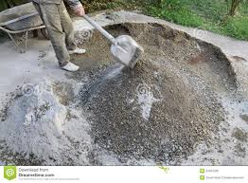
Mixing

Slide 7
PROCEDURE
Average thickness of cement plastering is 12 to 15mm. Projections more than 12 mm is cleared from the surface.
Surface preparation
Joints are cleared with wire brush to remove loose mortar & dust.
Clean the surface with water . Keep the surface wet till the application of plaster
Method of Application
Preliminary coat is applied to fill the hollow portions of the masonry.

Slide 8
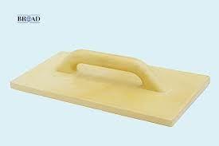
Tools
Wire brush
Float
Trowel

Slide 9
The first coat is now applied with a thickness of 9 to 10mm
To maintain the uniform thickness screeds( vertical strip of mortar) are formed by fixing dots.
A dot of size 150 x 150mm with a small quantity of plaster is fixed. Another dot is placed vertically 2m below the first. The dots are levelled with the help of a plumb bob
After fixing the dots, a vertical strip of mortar is applied b/w the dots (screed).

Slide 10
Sufficient no. of screeds are prepared & mortar is applied in b/w the screeds using trowel.
The 2nd coat is applied after 6 hours with a thickness of 10mm.
A 3rd coat of max: thickness 3mm is applied , if required.
The completed plaster is allowed to rest for 24 hours & it is well watered for atleast 1 week.

Slide 11
Floating rule

Slide 12
Defects in plastering
Blistering of plastering surface-small patches well out in plastered surface
Cracks- formed in plastered surface
Efflorescence-soluble salts in plaster making material causes whitish surface.
Flaking- formation of loose mass on plastered surface
Peeling- surface comes off and patch is formed
Rust stains- appear on plaster on metal lath
Softness- due to poor workmanship.

Slide 15
FLAKING

Slide 16
EFFLORESCENCE

Slide 19
PEELING

Slide 21
RUST STAINS

Slide 22
SOFTNESS IN PLASTERING

