Slide 1
ENGINEERING GRAPHICS SESSION-5 DIMENSIONING
ARAVIND R
LECTURER IN M.E.
GPTC ADOOR

Slide 2
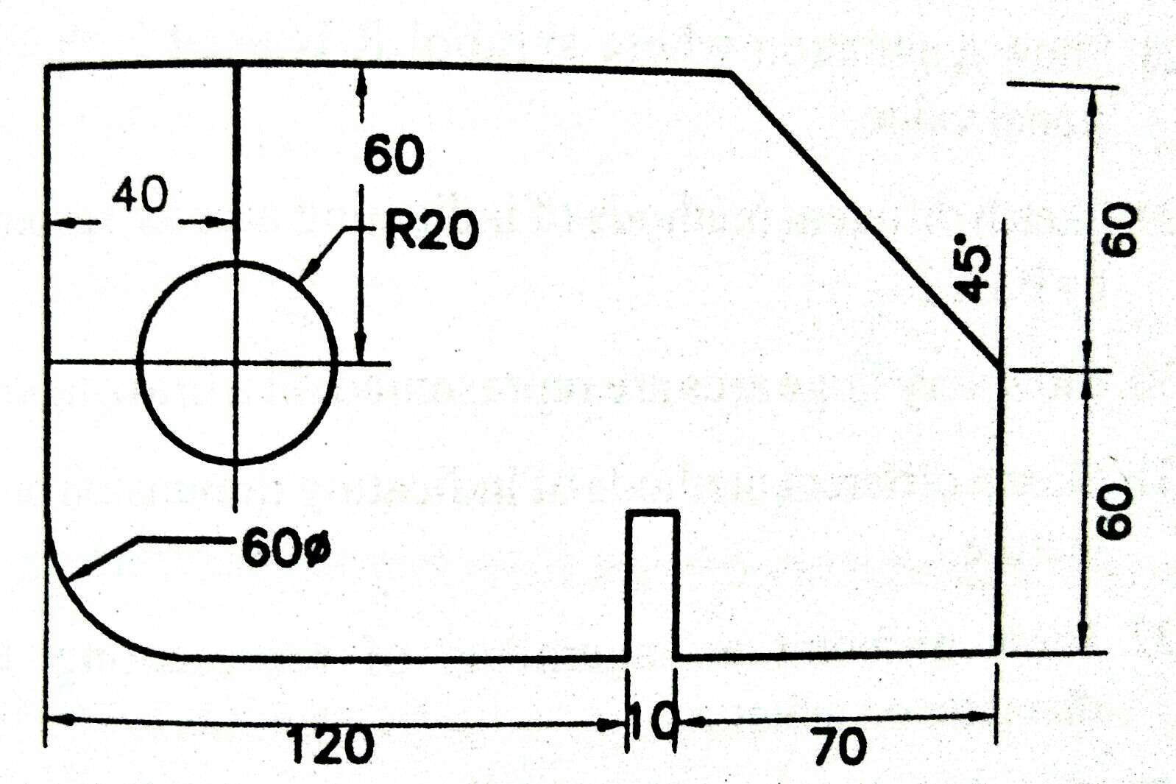
1. Redraw the figure and dimension it as per BIS

Slide 3
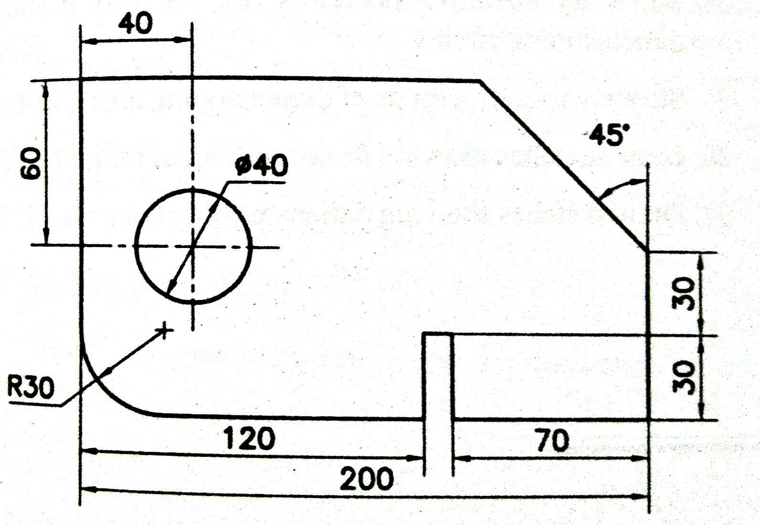
SOLUTION

Slide 4
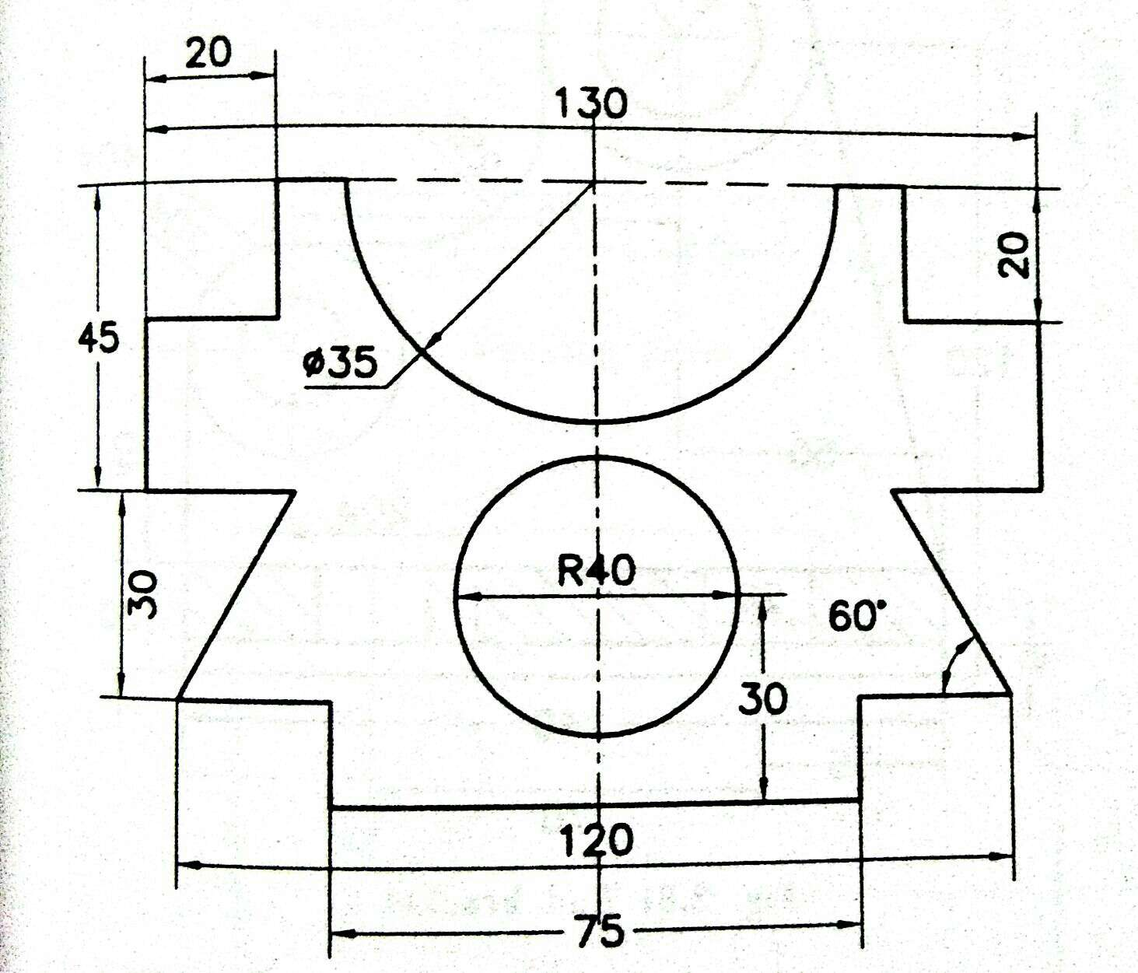
2. Redraw the figure and dimension it as per BIS

Slide 5
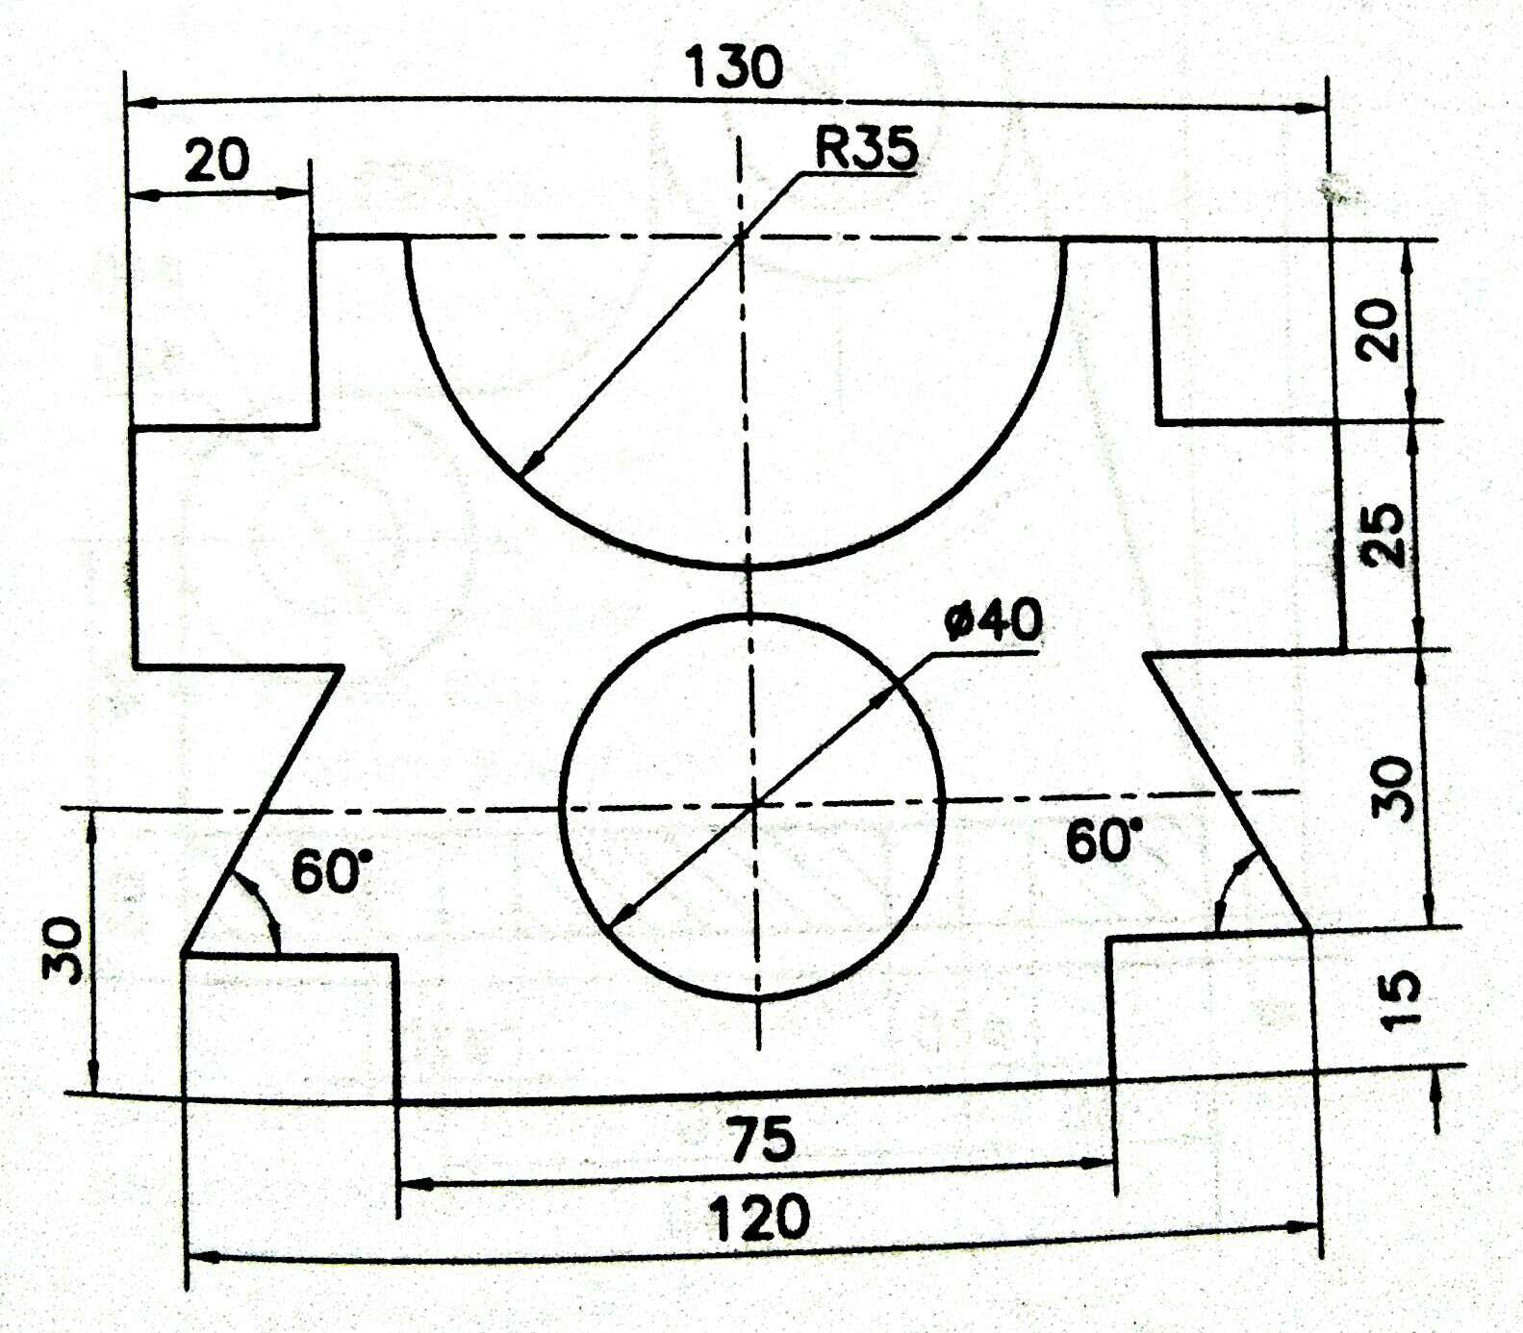
SOLUTION

Slide 6
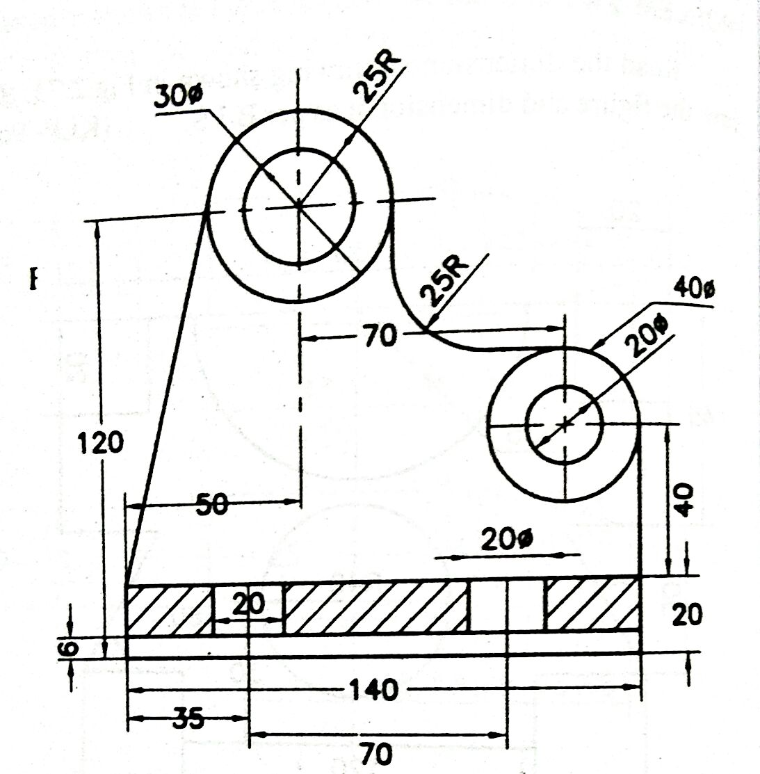
SELF ASSESSMENT

