Slide 1
FORGING(Module 3)
Forging is a metal working process by which metals and their alloys are plastically deformed to the desired shape by application of compressive force
Machine forging is employed for the production of medium and large sized forging
It employs either forging hammers (sudden blows) or forging presses (steady pressure) to shape the metals
Forging parts: Crank shaft and connecting rods for engine, turbine discs,gears,wheels etc

Slide 2
Advantages of forging
Rapid duplication of components
Less machining time after forging
Components can be produced to close tolerance
High strength to weight ratio
Improve directional properties
Improve grain structure and hence mechanical properties are improved (Strength, Toughness)
Elimination of internal defects such as porosity, blowholes etc
8. Metals can be easily shaped to the required dimensions using forging die.
9. Can withstand unpredictable loads during service

Slide 3
Limitations of forging
The initial cost of the equipments and dies is high.
Intricate and cored shapes cannot be produced by forging
Size and shape is limited as compared to casting process.
The forged part costs more than the cast part
In hot forging ,due to oxidation, poor surface finish is obtained

Slide 4
SMITHING or HAND FORGING
Work piece is heated to required temperature(in an open fire or hearth), placed in anvil and shaped with suitable hand hammer
Work done is smithy shop
The type of smithy operations are fullering, flattening, bending , upsetting and swaging.

Slide 5
HAND FORGING TOOLS
ANVIL
SWAGE BLOCK
HAMMERS
TONGS
CHISEL
SWAGES
FULLERS
SET-HAMMER
PUNCH AND DRIFT

Slide 6
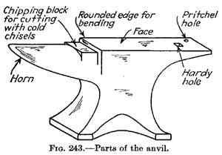
ANVIL BLOCK

Slide 7
ANVIL BLOCK
Support work while hammering.
Body made of wrought iron or cast steel with hardened top(face)
Beak or horn used for bending curved shapes
Hardy hole is used for inserting square shank tools such as swages and fullers for swaging and fullering operation
Pritchel hole is used for bending rod of small dia and die for punching
It weights from 80 to 300 Kgs
Resting over C.I base.

Slide 8
SWAGE BLOCK
Made of cast steel or cast iron
It has round,square,rectangular and half round grooves for swaging, bending ,shaping and finishing work piece

Slide 9
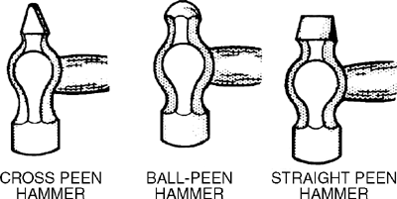
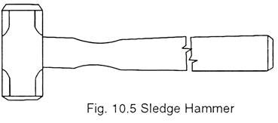
HAMMERS
HAND HAMMERS
Striking tools made of forged steels. Weight varies from 0.5 to 2 kg
Ball pein –It has a flat striking face and ball shaped pein. Flat face for general work and ball end for riveting
Cross peen
It has a flat striking face and a wedge shaped pein across the eye. Used for bending, stretching and hammering inside the curves and shoulders
Straight Pein: Similar to cross pein except that pein is parallel to eye. Used for stretching metals.
SLEDGE HAMMER - used by the striker when heavy blows are needed
Weight varies 3 to 8 kg.

Slide 10
TONGS
Used for gripping the hot work piece.
Flat tongs – closed mouth: Holding thin sections
Flat tongs – open mouth: Holding heavier sections
Round hollow tongs: Holding round, hexagonal & orthogonal work
Square hollow tongs: Used for square, hexagonal & orthogonal work
Pick up tongs(Gad tongs)- Picking up round bars. Not used for holding work during forging

Slide 11
Tongs

Slide 12
CHISEL
Used for cutting metals
Chisels may be hot or cold depending on the metal is hot or cold
Difference is in the cutting edge.
Cold chisel- edge hardened and tempered- 60⁰
Hot chisel- 30⁰, hardening not necessary.

Slide 13
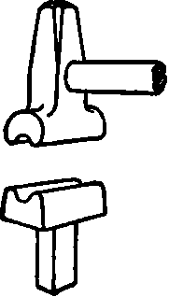
SWAGES
Pair of swages
Used when work has to be reduced and finished to round ,square and hexagonal.
Made with half grooves
Top part having handle and bottom part having square shank to fits in the hardie hole.

Slide 14
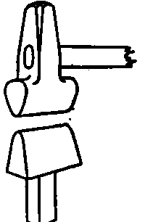
FULLERS
Used for necking(reducing cross section) and grooving operation
Made in pairs consisting of a top fuller with handle and bottom fuller with a square shank to fit into the hardie hole
Pair of fullers

Slide 15
FLATTERS AND SET HAMMER
FLATTERS OR SMOOTHERS
Used to give smoothness and accuracy to articles which have already been shaped by fullers and swages.
SET HAMMER
Similar to flatter but smaller in size
Used for finishing corners in shouldered work where flatter many not work due to confined space.
Also used for drawing out.

Slide 16
PUNCH AND DRIFT
punch is used for making holes in metal part when it is at forging heat.
Holes are opened out by driving through a large tapered punch called a drift.

Slide 17
CLASSIFICATIONS OF FORGING PROCESS
1. Open die forging
Metal shaped between two flat dies or dies with grooves of simple shape
Advantages: Simple to operate, low tooling cost, wide range of work piece size can be used
Disadvantages: Suitable for simple shapes and low production volume, difficult to maintain tolerance, less control in determining grain flow and mechanical properties
1. hand forging – done by hand on anvil
2. hammer forging – done by using power hammers
3. press forging – done by power press

Slide 18
OPEN DIE FORGING

Slide 19
2. Closed(impression) die forging
Cavities or impression are cut in die blocks (top and bottom dies)in which metal are forced to takes its final shape and dimensions
Small amount of material forced outside the die impression forming flash that is generally trimmed
Depending upon equipment used
1. Drop hammer forging
2.Press forging
3.Upset machine forging

Slide 20
Advantages
Rapid duplication of component
Used for production of complex shapes
Grain flow of material can be controlled, ensuring mechanical properties
Less time consuming, high production rate, suitable for mass production
Forging are made with less machining allowance, reduction in machining time and metal required for forging
Disadvantage
More than one step is required for producing complex shapes
High equipment and tooling cost
Appropriate die set is required for production of each component

Slide 21
CLOSED DIE FORGING

Slide 22
Smith forging operations
Upsetting
Drawing down
Setting down
Swaging
Punching
Bending
Welding
Cutting

Slide 23
UPSETTING OR HEADING
Process of increase the thickness or diameter of a material at the expense of its length.
Opposite to drawing dawn
Process involves heating the bar and heavy blows are given at the end by hand hammer.

Slide 24
UPSETTING
Effect of heavy blows when
a. Heating done at one end
b.Heating done at both ends
c.Heating done at centre

Slide 25
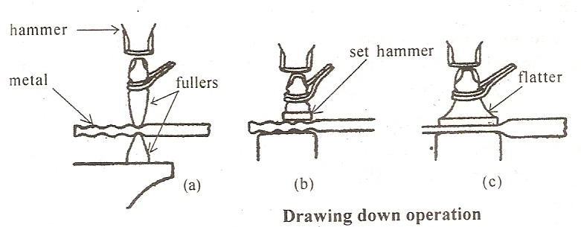
DRAWING DOWN
Process of increasing the length of a bar and reduction in cross section

Slide 26
SETTING DOWN
It is a localized drawing down
Local thinning effected by the set- hammer

Slide 27
PUNCHING & DRIFTING

Slide 28
PUNCHING
Process of producing hole in a metal piece using a hot punch and die or over pritchel hole of anvil
Metal with hole is the required product and part removed is the scrap.
In blanking blank is the useful product.

Slide 29
BENDING
The part to be bend is heated to plastic form and then hammered by placing it on the anvil side.
Bend shapes such as circles , ovals , and angles can be done by bending operations
Finishing operations is carried out by means of set hammer.

Slide 30
BENDING

Slide 31
FORGE WELDING
Parts to be welded are heated , mating surfaces are then upsetted.
Cleft shape is formed at the mating surfaces.
Applying excess pressure at the mating surfaces by hammering.
Carried-out for wrought iron and low carbon steel, thickness above 30 mm.
Fluxes used

Slide 32
CUTTING
Cutting operation is the removal of extra metal from the job.
Hot state cutting and cold state cutting.
In hot state cutting steel is heated between 900⁰ to 1000 ⁰c and hot chisel is used.

Slide 33
CUTTING

