Slide 1
FOUNDATION

Slide 2
FOUNDATION

Slide 3
INTRODUCTION
A structure essentially consists of two parts, namely the super structure which is above the plinth level and the substructure which is below the plinth level.
Substructure is otherwise known as the foundation and this forms the base for any structure.
The soil on which the foundation rests is called the “foundation soil”.

Slide 4
OBJECTIVES OF A FOUNDATION
To distribute the total load coming on the structure on a larger area.
To support the structures.
To give enough stability to the structures against various disturbing forces, such as wind and rain.
To prepare a level surface for concreting and masonry work.
Provide stability against sliding

Slide 5
TYPES OF FOUNDATION
The two main types of foundation are :
Shallow foundation D≤1m
Deep foundation D≥15m
Types of Shallow foundation :
Isolated footing /Column footing
Combined footing
Wall footing/spread footing
Raft footing/mat footing
Types of Deep foundation :
Pile foundation
Pier foundation

Slide 6
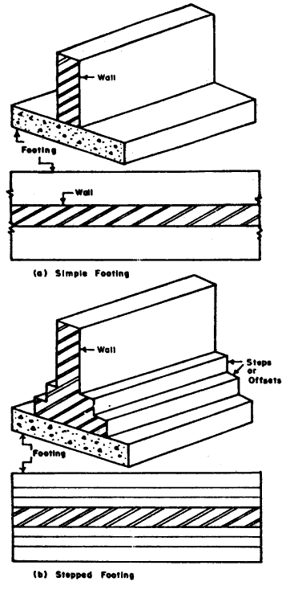
Wall footing
Footing provide under wall
It may be simple or stepped footing
Light loads-simple
Heavy loads-stepped
For simple footing width is 2or 3 times b

Slide 7
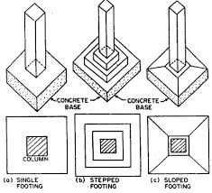
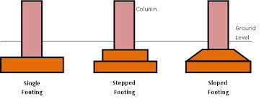
Isolated footing

Slide 8
Isolated footing
Column footing is used to support isolated columns
It may be stepped or sloped
R C C footing is provided- when column loads are heavy
Thickness isolated footing depends-
Load acting on column
Width of footing

Slide 9
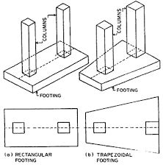
Combined footing

Slide 10
Combined footing
A common footing constructed for 2 or more columns
It is provided when
the space between two columns is so small that the foundation for individual columns will overlap.
External column situated near boundary
Combined footing may be rectangular or trapezoidal

Slide 11
Combined footing
Rectangular – load acting on 2 columns are almost equal
Trapezoidal-
Load acting on one of the column is heavy
One of the column is very near to boundary
Combined footings are proportioned in such a way that the centre of gravity of the loads coincides with the centre of gravity of the foundation. Hence these footings have either a trapezoidal or a rectangular shape.

Slide 12
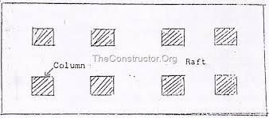
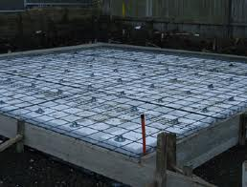
Raft footing

Slide 13
Raft footing
It is a concrete slab which cover the entire area below the building and support all the walls n columns
If column loads are heavy-RCC slabs are provided

Slide 14
Raft footing
Mat footing is used in the following situations
When soil is soft clay or made up lands or marshy land with low bearing capacity
Building loads are heavy so that individual column footing may overlaps
Where there is a chance for differential settlement
It is used in highly compressible soil to reduce settlement
When columns are very close so that column footing cover more than half of the total area

Slide 15
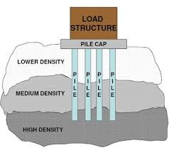
PILE FOUNDATION

Slide 16
PILE FOUNDATION
Pile is a long vertical member used to transfer the load of structure to soil
It is a deep foundation used to transfer the heavy loads of building to hard bearing strata of good bearing capacity
Pile may be driven vertically or slightly inclined-battened pile
Foundation consist of pile- pile foundation

Slide 17
TYPES OF PILES
According to materials used
Concrete Piles
i) Cast-In-Situ Concrete Piles ii) Precast Concrete Piles
Steel Piles
i) H-Piles ii) Cylindrical piles iii) Tapered piles
Timber Piles
RCC piles
Composite Piles
According to load carrying capacity
Load bearing piles
End bearing piles
Friction piles
Non load bearing piles

Slide 18
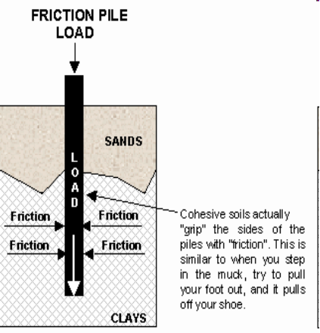
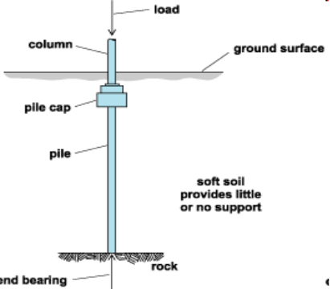
Load Bearing Pile
Friction Piles

Slide 19
If a load bearing pile rest on hard strata and transfer the load through the tips- end bearing piles
When loose soil is extended to greater depth piles are driven to such a depth that friction between pile surface and surrounding soil will resist the load- Friction piles

Slide 20
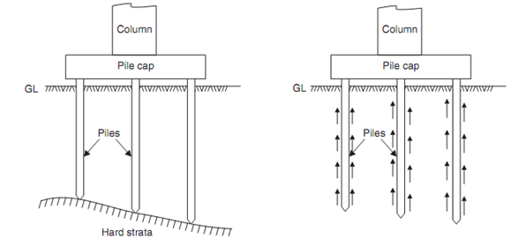
End Bearing Pile & Friction Piles

Slide 21
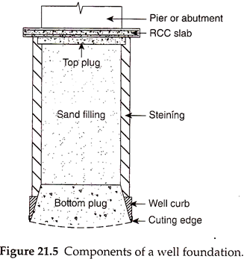
Well foundation

Slide 22
Well foundation is a type of deep foundation which is generally provided below the water level for bridges.
Box cassion:
It is open at the top and closed at the bottom and is made of timber, reinforced concrete or steel. This type of cassion is used where bearing stratum is available at shallow depth.
(ii) Open cassion (wells):
Open cassion is a box opened both at top and bottom. It is made up to either timber, concrete or steel. The open cassion is called well. Well foundation is the most common type of deep foundation used for bridges in India.

Slide 23
(iii) Pneumatic cassions has its lower end designed as a working chamber in which compressed air is forced to prevent the entry of water and thus excavation can be done in dry conditions.
Shapes of Wells:
The common types of well shapes are:
(i) Single circular
(ii) Twin circular

Slide 24
(iii) Dumb well
(iv) Double-D
(v) Twin hexagonal
(vi) Twin octagonal
(vii) Rectangular.

Slide 25
