Slide 1
MODULE IV COMPOUNDING FOR THE VULCANIZATE PROPERTIES

Slide 2
4.1.0. Able to apply principles of compounding for the design of various recipes to meet the vulcanizate properties
4.1.1. Explain the general principles of compounding, chart out the properties of elastomers.
4.1.2. Describe the elements to be considered for preparing a formulation and a product.
4.1.3. Describe the method for calculation of specific gravity and volume cost of a compound with examples.
4.1.4. Explain compounding to meet processing requirements.
4.1.5. Explain the effect of particle size and structure of filler on processing and vulcanisate properties.
4.1.6. Design compounds for a particular ‘shore A’ hardness and modulus using black and nonblack fillers.
4.1.7. Describe the factors to be considered for compounding specific vulcanisate properties such as abrasion resistance, hardness, tensile properties, tear resistance, oil resistance, heat,light,flame, oxygen and ozone resistance.

Slide 3
STAGES OF PRODUCT DEVELOPMENT
Compound Design
Lab Evaluation
(mixing, moulding, extrusion,
calendaring, fabrication of product,
curing, etc ),
Analysis of feedback
Compound Modification (if reqd.),
Testing of processing properties
and of finished product
Field trials
Validation of manufacturing
process.

Slide 4
Objective of Rubber Compounding
To secure certain properties in the finished product to satisfy service requirements.
To attain processing characteristics necessary for efficient utilization of available equipment.
To achieve the desirable properties and processability at lowest possible cost.
The most important factor in compounding is to secure an acceptable balance among demands arising from the above three criteria ( final vulcanizates properties, cost and processability)

Slide 5
Major Objectives of Compound Development
Resistance to Degradation
Heat, Oxygen, Ozone
Flame
Liquids
Light
Metal poisoning
Miscellaneous property requirements
Low temperature flexibility
Electrical properties
Swelling
Permeability
Bonding to metals & textiles
Contact with food stuff and drugs etc.

Slide 6
Major Objectives of Compound Development
Process Requirement
Proper mixing ( Incorporation, dispersion, distribution and plasticisation)
Viscosity/process safety
Stickiness and tackiness
Shaping ( Calendaring, Extrusion, Assembling and Moulding)
Compound property requirement
Hardness
Stress-strain properties
Abrasion resistance
Hysteresis & Set properties
Resistance to cut growth, fatigue, flex cracking

Slide 7
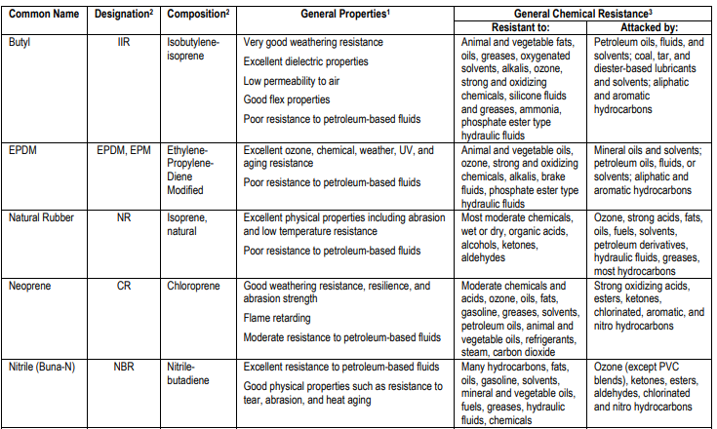
GENERAL PROPERTIES OF ELASTOMERS SUMMARY CHART

Slide 8
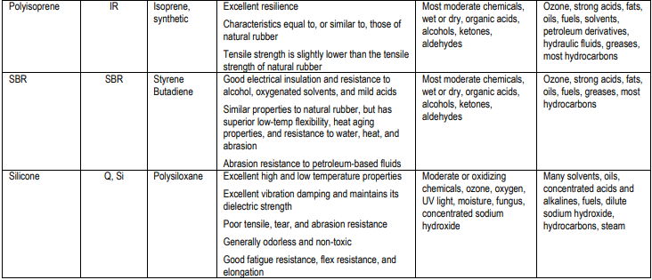
GENERAL PROPERTIES OF ELASTOMERS SUMMARY CHART

Slide 9
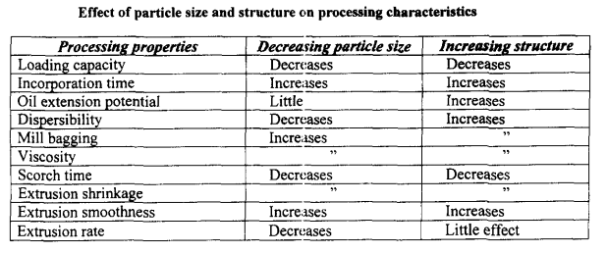
EFFECT OF PARTICLE SIZE AND STRUCTURE OF FILLER ON PROCESSING AND VULCANIZATES PROPERTIES
Filler particle size is the most important property which influences reinforcement
Requirement for rubber reinforcement is sufficiently small domain size, < 1 µm.
The most important single factor which determines the degree of reinforcement is the development of a large polymer-filler interface.
It can be provided only by particles of colloidal dimensions

Slide 10
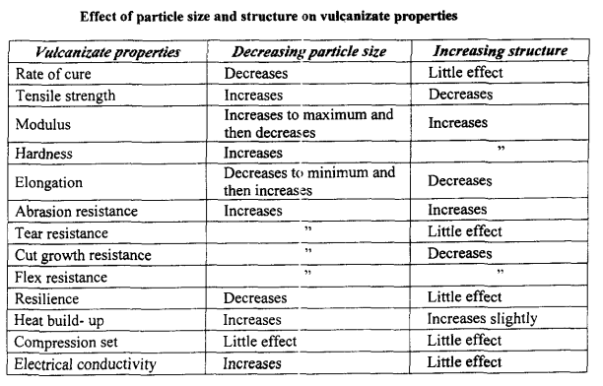
EFFECT OF PARTICLE SIZE AND STRUCTURE OF FILLER ON PROCESSING AND VULCANIZATES PROPERTIES

Slide 11
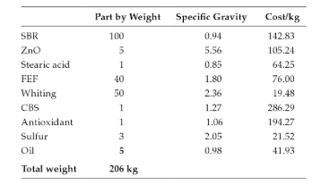
COST OF COMPOUND
CALCULATE THE SPECIFIC GRAVITY AND COST PER KILOGRAM OF THE FOLLOWING COMPOUND

Slide 12
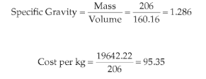
COST OF COMPOUND

Slide 13
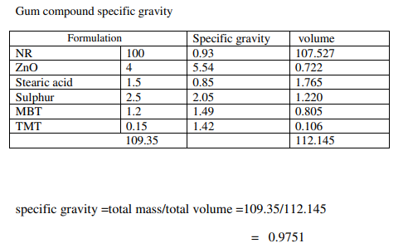
DESCRIBE THE METHOD FOR CALCULATION OF SPECIFIC GRAVITY
Design a NR compound for specific gravity 1.155 by using HAF as filler.

Slide 14
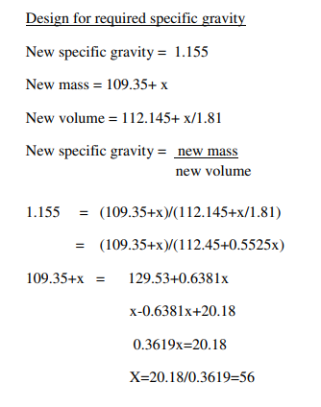
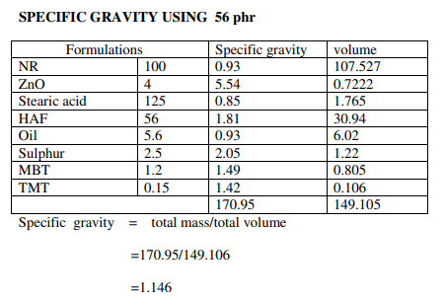
Design a NR compound for specific gravity 1.155 by using HAF as filler.

Slide 15
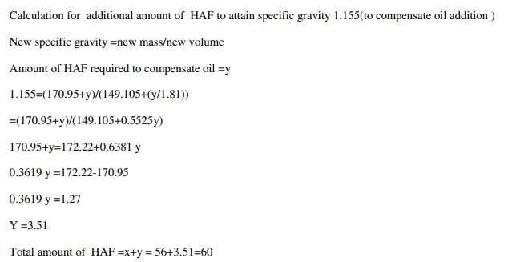
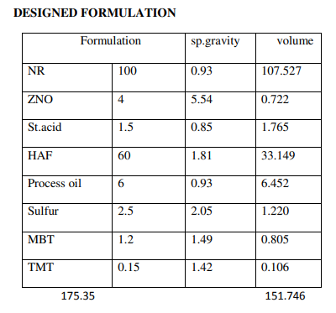
Design a NR compound for specific gravity 1.155 by using HAF as filler.

Slide 16
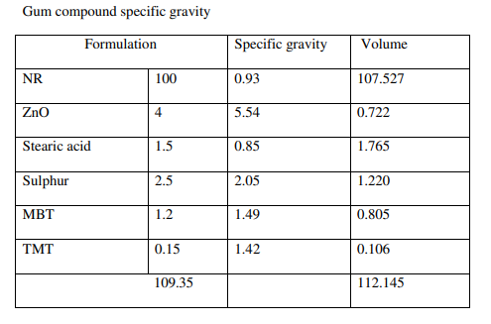
Design a NR compound for specific gravity 1.178 by using SILICA as filler.

Slide 17
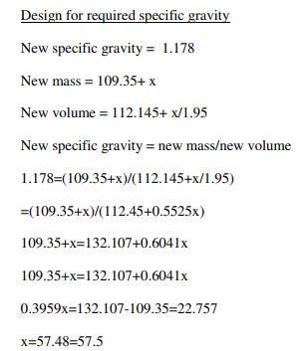
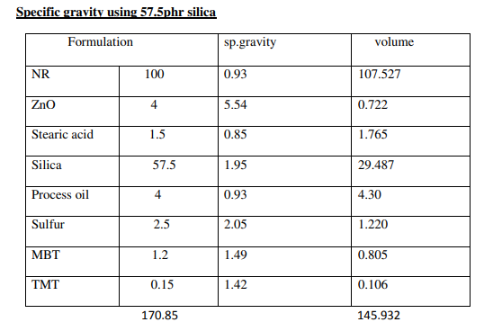
Design a NR compound for specific gravity 1.178 by using SILICA as filler.

Slide 18
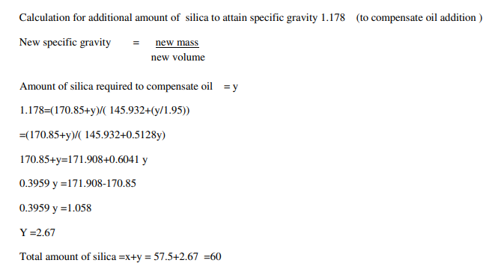
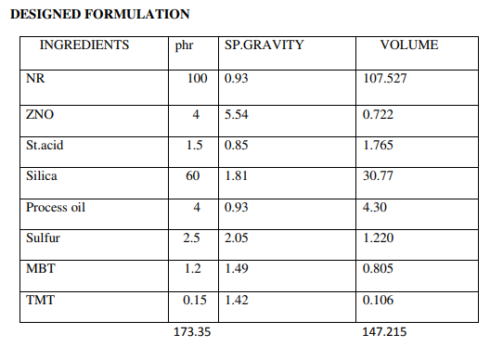
Design a NR compound for specific gravity 1.178 by using SILICA as filler.

Slide 19
HARDNESS
Measure of the resistance a material has to indentation
Gives a measure of the modulus at low strains.
Hardness and modulus of a vulcanizates are normally increased by the use of particulate fillers, especially carbon black and silica.
Compounding which produces increases in hardness also produces increases in the higher strain moduli values.
Softeners and plasticizers reduce hardness
Mineral oils are widely used in general purpose polymers as low cost softeners, produces a hardness drop of 1 IRHD for each two parts added.

Slide 20
HARDNESS
Polymer Hardness |  |  |  | phr required for 1 unit increase in Hardness
NR | SBR | CR | NBR
37-40 | 39-41 | 41-43 | 42-44
2 | 1.6 | 1.5 |  | Ppt. Silica
3 | 3.3 | 2.2 |  | Calcium silicate
5 | 4.1 | 4.5 |  | Hard clay
7.9 | 5.6 | 5.0 |  | Soft clay
6.6 | 8.4 | 5.0 |  | Whiting

Slide 21
NR | SBR | IIR | CR | PBR | NBR | EPDM | Black | ASTM Dsgn | DBP
1.5 | 1.8 | 1.3 | 1.2 | 2.2 | 1.7 | 2.4 | SAF | N110 | 113
1.7 | 2.0 | 1.5 | 1.3 | 2.5 | 1.9 | 2.7 | ISAF | N220 | 114
1.9 | 2.3 | 1.7 | 1.5 | 2.8 | 2.1 | 3.0 | HAF | N330 | 102
2.3 | 2.8 | 2.1 | 1.8 | 3.4 | 2.6 | 3.7 | FEF | N550 | 119
2.5 | 3.1 | 2.3 | 2.0 | 3.8 | 2.9 | 4.1 | GPF | N660 | 90
2.8 | 3.4 | 2.5 | 2.2 | 4.2 | 3.2 | 4.5 | SRF | N774 | 70
2.1 | 2.6 | 1.9 | 1.7 | 3.2 | 2.4 | 3.4 | HAF-LS | N326 | 72

Slide 22
DESIGN COMPOUNDS FOR A PARTICULAR ‘SHORE A’ HARDNESS AND MODULUS USING BLACK AND NONBLACK FILLERS
DESIGN NR COMPOUNDS OF 40,50,60,70 SHORE A HARDNESS USING HAF AS FILLER
Base hardness of NR = 38 Shore A
Filler to oil ratio = 10: 1
As a thumb rule, as the amount of filler loading increases, there will be a corresponding increase in hardness.
1.9 phr of HAF will increase 1 shore A hardness.
2 phr of oil will decrease 1 shore A hardness.

Slide 23
Required Hardness ( Shore A)
Balance Hardness ( Shore A)
Amount of HAF required for increase in hardness
Amount of Oil required
Decrease in hardness value due to oil addition (2phr oil)
Amount of HAF required to compensate oil addition
Total amount of HAF required
Total amount of process oil required
40
2
2*1.9 =3.8~4
4/10 =0.4
0.4/2 =0.2
0.2*1.9 =0.38~0.4(0.5)
4+0.5=4.5
4.5/10=0.45
50
12
12*1.9 =22.8~23
23/10 =2.3
2.3/2 =1.15
1.15*1.9 =02.185~2.2
23+2.2=25.2
25.2/10=2.52
60
22
22*1.9 =41.8~42
42/10 =4.2
4./2 =2.1
2.1*1.9 =3.99~4
42+4=46
46/10=4.6
70
32
32*1.9 =60.8~61
61/10 =6.1
6.1/2 3.05
3.05*1.9 =5.795~5.8 (6)
61+6= 67
6.7/10=6.7

Slide 24
FORMULATION BASED ON CALCULATED VALUES
Ingredients | 40 Shore A | 50 Shore A | 60 Shore A | 70 Shore A
Natural Rubber | 100 | 100 | 100 | 100
ZnO | 4 | 4 | 4 | 4
Stearic acid | 2 | 2 | 2 | 2
Antioxidant SP | 1 | 1 | 1 | 1
HAF | 4.5 | 25 | 46 | 67
Process Oil | 0.45 | 2.5 | 4.6 | 6.7
CBS | 1.2 | 1.2 | 1.2 | 1.2
TMTD | 0.2 | 0.2 | 0.2 | 0.2
Sulphur | 2.5 | 2.5 | 2.5 | 2.5

Slide 25
DESIGN COMPOUNDS FOR A PARTICULAR ‘SHORE A’ HARDNESS AND MODULUS USING BLACK AND NONBLACK FILLERS
DESIGN NR COMPOUNDS OF 40,50,60,70 SHORE A HARDNESS USING ISAF AS FILLER
DESIGN NR COMPOUNDS OF 40,50,60,70 SHORE A HARDNESS USING GPF AS FILLER
DESIGN NR COMPOUNDS OF 40,50,60,70 SHORE A HARDNESS USING SILICA AS FILLER

Slide 26
COMPOUNDING FOR SPECIFIC VULCANISATE PROPERTIES
Tensile strength
Force per unit area of original cross-section which is required to break the test specimen.
At relatively low hardness levels, highest tensile strength are more easily obtained using high gum strength polymers which crystallise on stretching such as NR, CR, IR.
Other polymers such as SBR, NBR and BR shows low gum strength, requires fine particle size reinforcing fillers to develop maximum strength.
Optimum levels vary from 30-60 phr.
Resistance to abrasion
Fine particle size fillers improves abrasion resistance
Optimum levels for maximum reinforcement 50 phr
Adjusted by blending rubbers ( NR/PBD has good abrasion resistance than NR alone)

Slide 27
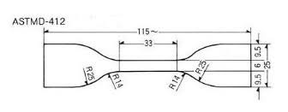
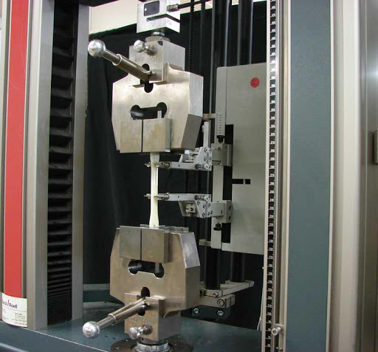
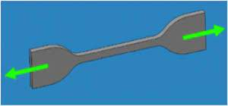
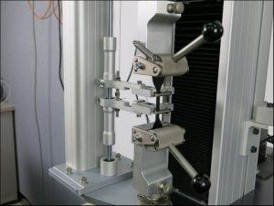

Slide 28
COMPOUNDING FOR SPECIFIC VULCANISATE PROPERTIES
Resistance to tear
Reinforcing fillers are not generally producing a noticeable effect in tear properties
Coarse fillers generally reduce tear values of mineral origin , particularly of large particle fractions
Resinous processing aids like CI resin, petroleum resins , phenolic resins are capable of improving tear resistance
Tear resistance falls appreciably with increasing temperature
Resistance to ozone
When stretched, vulcanizates are exposed to ozone, even at low concentrations.
Particularly under dynamic conditions, cracking develops at right angles to the direction of strain, the rate of cracking varying markedly from one polymer to another and being influenced by the compounding employed.
P-phenylene diamine and their derivatives can be used as antioxidants as wells as antiozonants.

Slide 29
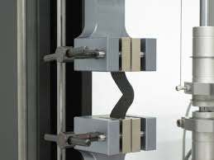
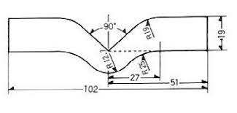

Slide 30
COMPOUNDING FOR SPECIFIC VULCANISATE PROPERTIES
Resistance to light and ozone
UV region of the spectrum has a much higher potential energy than the Visible or IR regions, the level being of an order capable of breaking down organic molecules.
In exposed vulcanizates, this shows itself as discolouration, surface embrittlement or break up in which oxygen also plays a part.
Carbon black, barium sulphate, calcium carbonate etc. have good UV reflectance characteristics.
Resistance to flame
Halogen containing polymers such as CR produce vulcanizates which are self-extinguishing.
Tricresyl phosphate, liquid chlorinated paraffin wax, antimony trioxide etc. can be used as processing aids.
The flame resistance of NBR can be improved by blending with PVC and using tricresyl phosphate plasticisation.

Slide 31
COMPOUNDING FOR SPECIFIC VULCANISATE PROPERTIES
Resistance to heat
Careful choice of cross linking systems and choice of other compounding ingredients can increase appreciably the maximum service temperature of a polymer.
Softeners, processing aids and plasticisers should be chosen so that they have long term thermal stability at the anticipated service temperature and are of low volatility.

