Slide 1
Types of windows

Slide 2
Casement windows
Double hung windows
Pivoted windows
Sliding windows
Louvered windows
Sash or glazed windows
Metal windows
Circular windows
Corner windows

Slide 3
Gable windows
Dormer windows
Bay windows
Clerestory window
Lantern lights
skylights

Slide 4
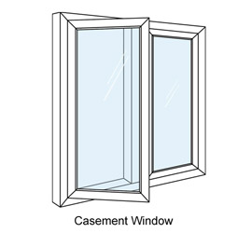
Casement window
Shutters opens like doors
Similar to construction of a door having frame,styles,rails,vertical and horizontal sash bar

Slide 5
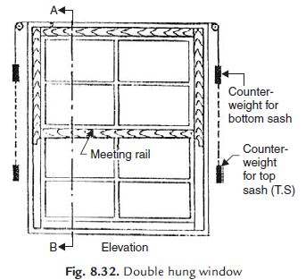
DOUBLE HUNG WINDOW
Consist of a pair of shutters which can slide within the grooves
Upper sash moves in downward direction
Lower sash in upper direction
A pair of weights connected on each sash
Ventillation is controlled and cleaning can be done easily

Slide 6
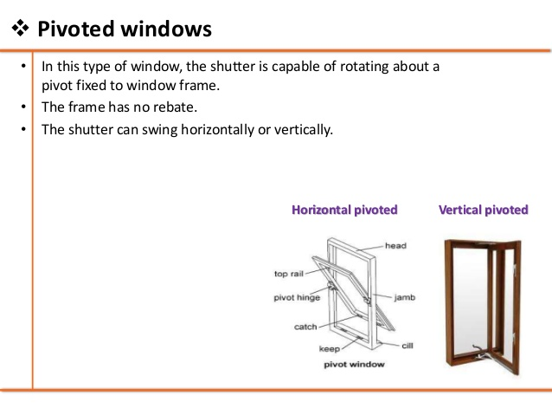
Pivoted window

Slide 7
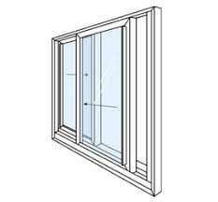
Sliding window
Similar to sliding doors
Shutters move on roller bearing horizontally or vertically
Used in trains,bus, bank counters,shops etc.

Slide 8
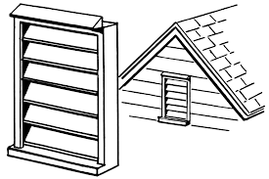
Louvered windows
Louvers are provided for this type of windows.
Shutter consist of top rail,bottom rail and styles grooved to receive louvers
Inclination of louvers=45ᵒ
Raised or lowered by mechanical operating device.

Slide 9
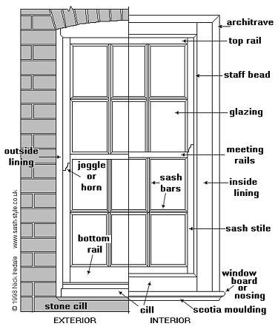
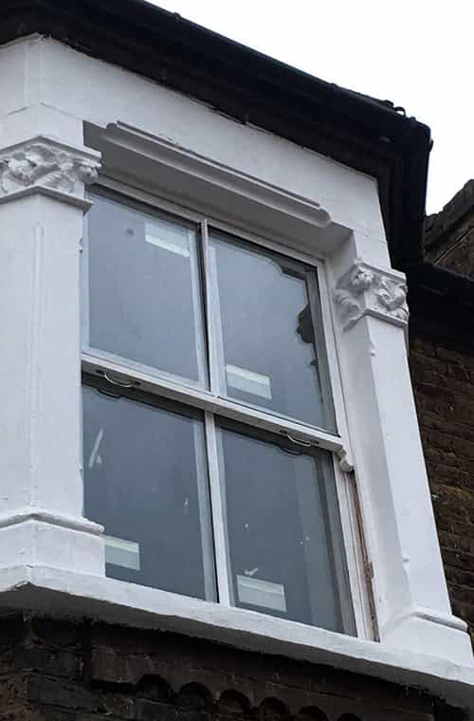
Sash and glazed window

Slide 10
Fully glazed casement windows.
Width and depth of rebates are 15mm and 5mm .
Glass is positioned either by putty or small fillets

Slide 11
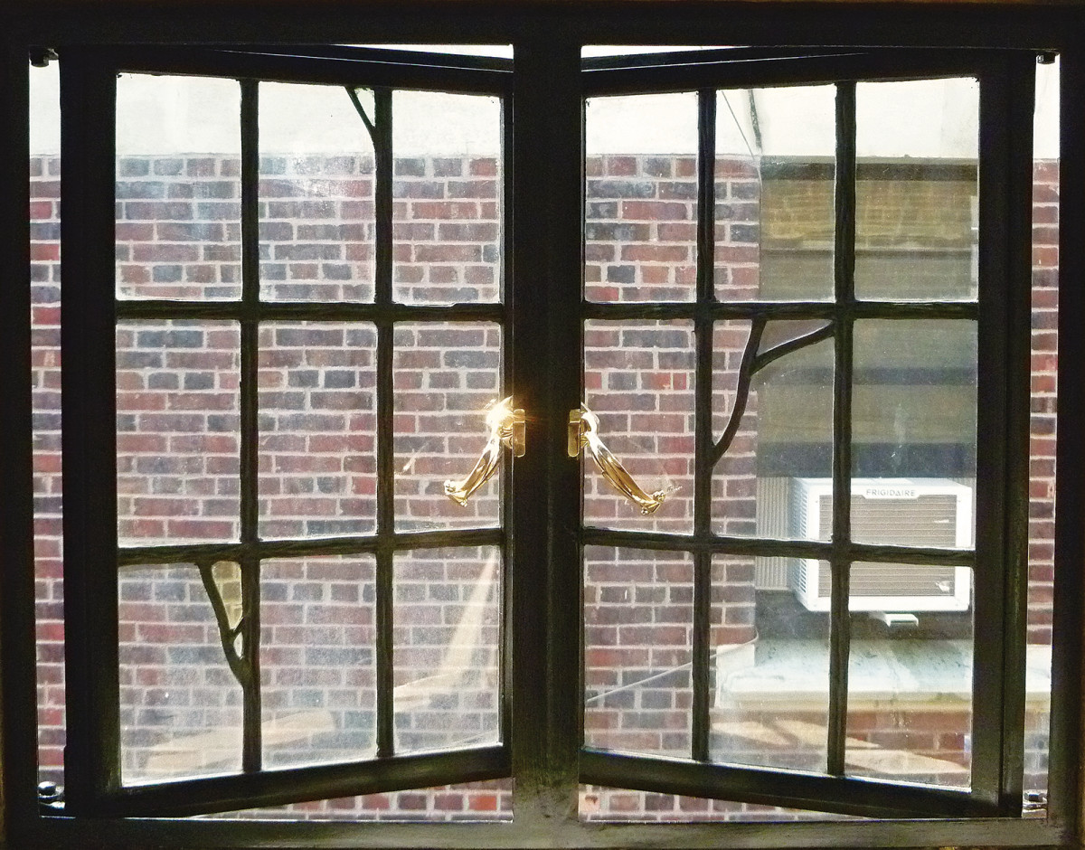
Metal windows
Widely used for public buildings.
Made of mild steel, bronze or alloys
Members of frame and sash should be properly welded.
Prevent corrosion to metal windows
Glass pannels properly fixed.

Slide 12
ADVANTAGES OF STEEL WINDOWS OVER WOODEN WINDOW
greater precision
no contraction or Expansion due to weather
Good apperance
Light in weight
Easy maintainance
Fire proof
Termite proof
More durable and strong.

Slide 13
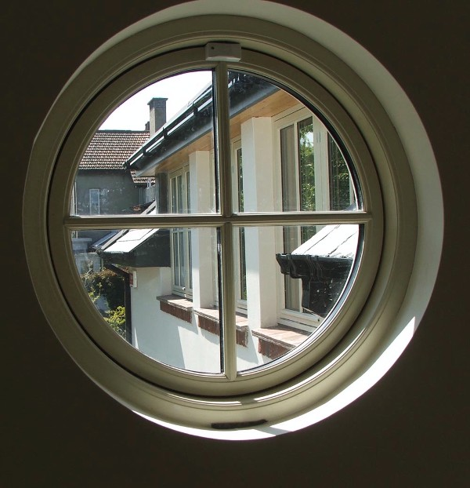
Circular window
Circular shape
Used in factories,workshops

Slide 14
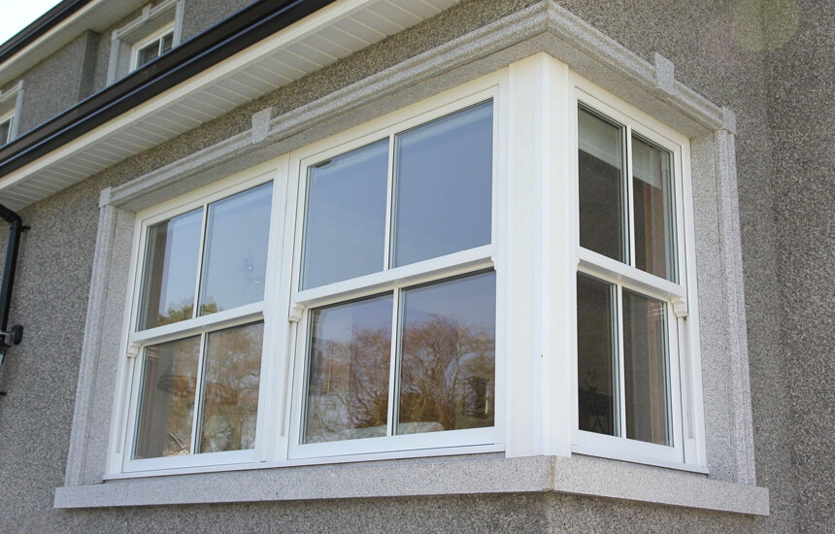
Corner window
Windows provided at corner of a room
Entry of light and air in 2 directions.
Heavy jamb sections to be placed
Special lintel at corner

Slide 15
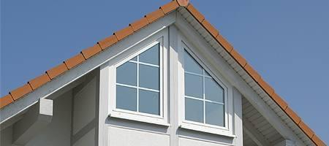
Gable window
Windows at ends of a roof

Slide 16
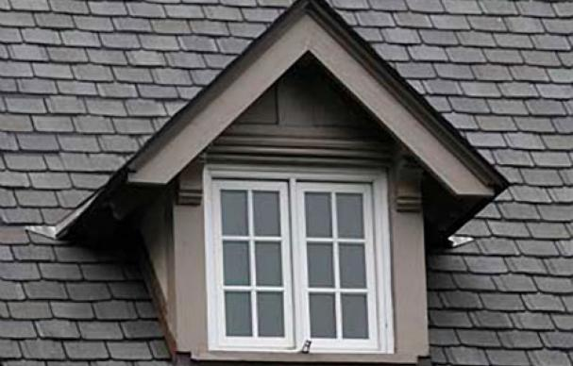
DORMER WINDOW
Windows on sloping roof
Main purpose is to admit light and air to rooms

Slide 17
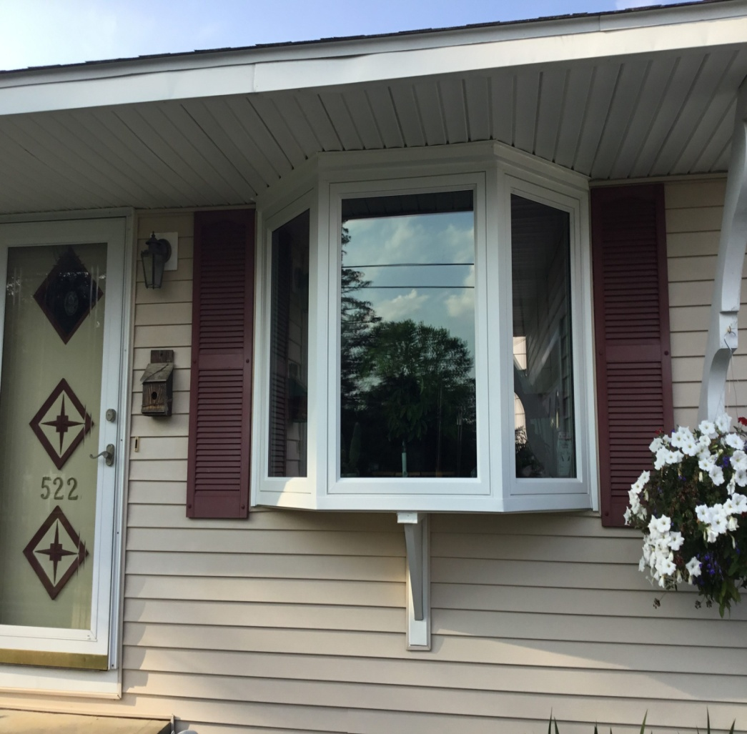
BAY WINDOW
Windows project outside external walls of a room
May be circular, square,polygonal.
Projection may start from floor level or sill level.

Slide 18
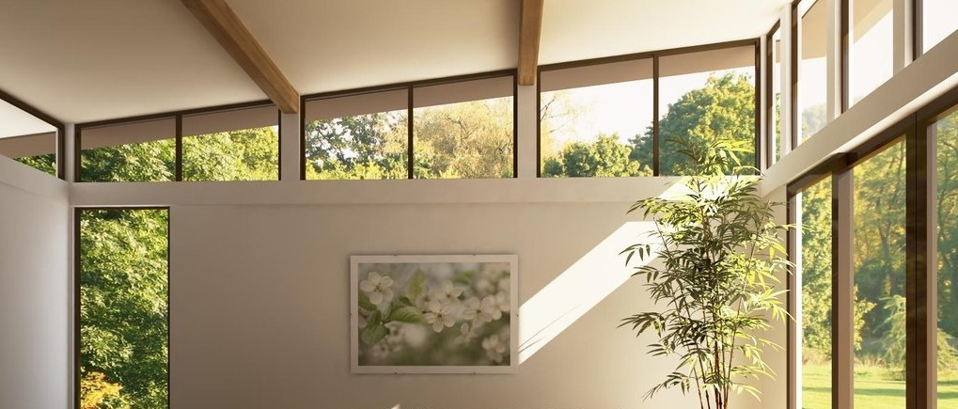
CLERESTORY WINDOW
Windows provided at near the top of main roof
Ventellation to inside room
Improves appearance

Slide 19
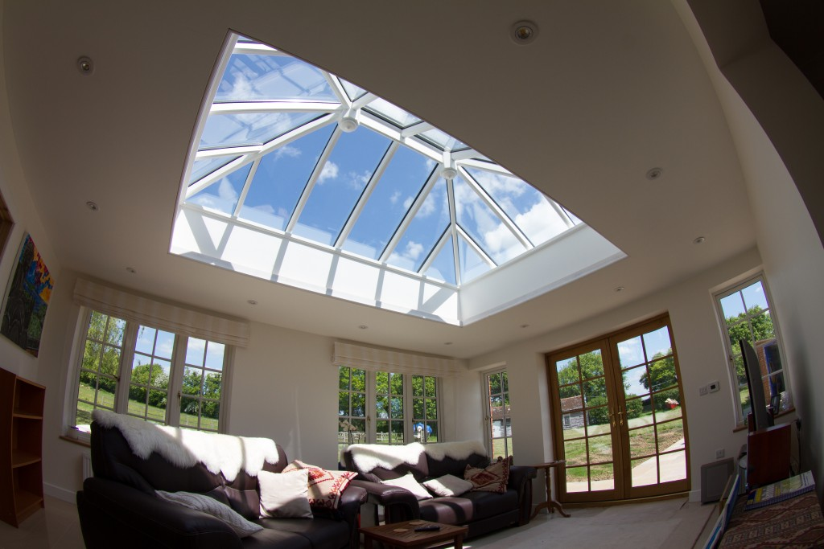
LANTERN LIGHTS
Provide light to inner portion of building
Rectangular or curved
Ventellation to addition to light

Slide 20
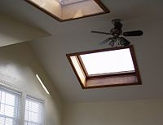
SKYLIGHT WINDOWS
Provided on sloping surface of pitched roof
Skylight with glass pannels.

