Slide 1
DOORS ,WINDOWS
AND VENTILATORS

Slide 2
DOOR- it is defined as an openable barrier in an opening left in a wall for access of users.
It consist of 2 parts-
Frame
Shutter
Window- it is defined as an opening made in wall for purpose of providing day light,vision and ventilation.

Slide 3
Important consideration for doors and windows
The main function of door is to connect link between various internal parts.
Number of doors should be kept minimum
Size of door
- the door should allow movement of largest object likely to use the door.
-Minimum width of interior door for public buildings( hospitals,library)=800mm,1m and 1.2m

Slide 4
Important consideration for doors and windows
Size of door
Height = width+1m to 1.2m
width= 0.4 to 0.6 of height
Size of window
- depends on dimension ,use ,location of room, speed of wind, obstruction of light by trees, buildings near by, relative humidity, climatic conditions.

Slide 5
Important consideration for doors and windows
Breadth of window=1/8( width of room+height of room)
For 30m³ room, atleast 1m² window opening is there.
Total area of window opening=(15% of floor area of room)
Total area of glass panels=(10% of floor area of room)

Slide 6
Important consideration for doors and windows
Location
-doors should be preferably located at corner of room
Sill of window opening at a height of 700mm to 800mm from floor level
Factors affecting light distribution, ventilation, wind direction should be considered

Slide 11
Technical terms
Style-outside vertical member of the shutter or door
Top rail- topmost horizontal member of the shutter
Lock rail- middle horizontal member of shutter where locking arrangement is made
Bottom rail-lowermost horizontal member of shutter.
Cross rail or intermediate rail-additional horizontal rails fixed between top and bottom rails
Panel-area of shutter enclosed between adjacent rails

Slide 12
Holdflast-it is mild steel flat bar of 200mm length x 30mmx 6mm.3 nos of hold fast are provided on each side of door.
Horn-horizontal projection of head or sill beyond face of frame.
Shutter-entire assembly of styles,panels and rails.
Sash-speccial type of frame made of light sections designed to carry glass.
Mullion-vertical member to divide a window or door vertically

Slide 13
Transom-Horizontal member to subdivide window horizontally
Louver- piece of timber fixed at inclined position within a frame
Jamb- vertical wall face of an opening which supports frame of a door or window
Reveal-external jamb of door or window right angle to wall face
Rebate-depression inside door frame to receive shutter
Putty- mixture of linseedoil and whiting chalk,used to fix glass panels

Slide 15
Types of doors
Ledged doors
Ledged and braced doors
Ledged and framed doors
Ledged framed and braced doors
Framed and panelled doors
Glazed or sash doors
Flush doors
Louvered doors
Collapsible steel doors
Revolving doors
Rolling steel doors
Sliding doors
Swing doors

Slide 16
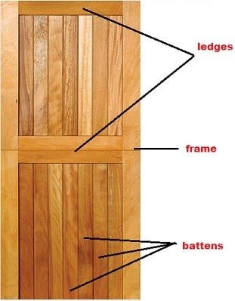
LEDGED DOORS

Slide 17
LEDGED DOORS
Battens are 100mm to 150mm wide and 20mm to 30mm thick
Ledges are 100 to 200mm wide and 30mm thick
3 ledges are there- top, middle and bottom
Battens are secured to shutter by T hinges

Slide 18
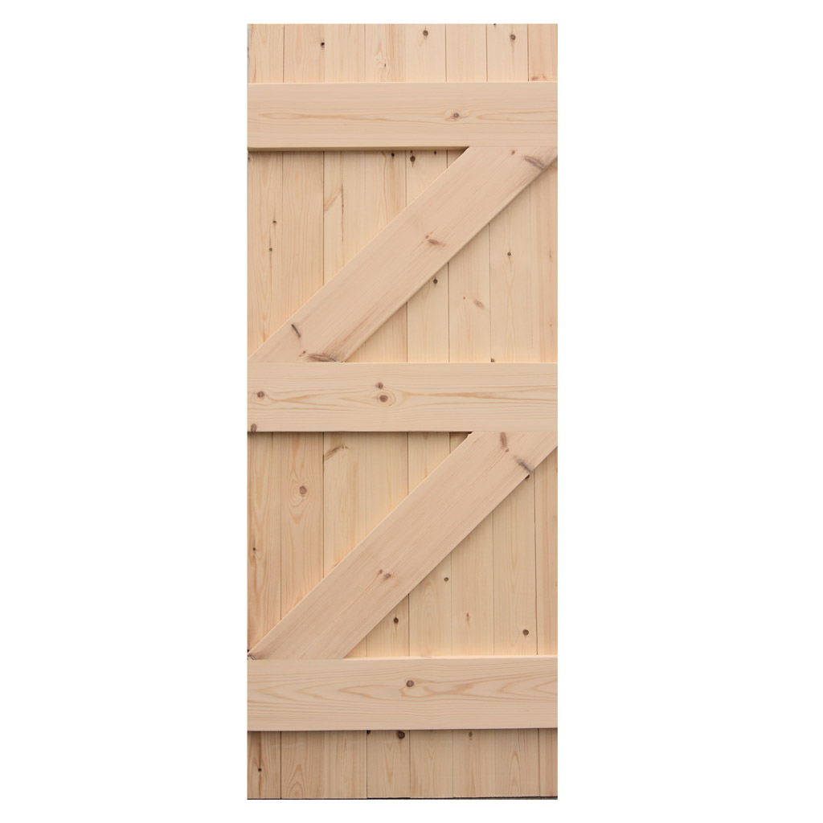
Ledged and braced doors

Slide 19
Braces are 100 to 150mm wide and 30mm thick
Braces give rigidity to door,hence useful for wide openings.

Slide 20
Ledged and framed doors
More durable and strong
Styles are 100 to 40mm thick

Slide 21
More durable and strong

Slide 22
Framed and panelled door and glazed door

Slide 23
Framed and panelled door
Most usual variety of door
It reduces tendency of shrinkage and presents a decent apperance
Styles are continous from top to bottom
Mullions are joined to rails
Thickness of shutter=30mm to 40mm
Thickness of panels=20mm

Slide 24
Glazed or sash doors
To admit more light,fully glazed or partly panelled and partly glazed doors are used
Use of glazed portion to panelled portion=2:1
Glass is received into rebates in wooden sash bars,secured by nails and putty

Slide 25
Flush doors

Slide 26
Consist of a frame work of rails and styles and is covered with plywood
Framed flush door consist of styles,rails,horizontal ribs,vertical ribs and plywood
Laminated flush door consist of styles,rails,laminated core and plywood

Slide 27
Flush door consideration
Timber should be properly seasoned
Termite proof treatment should be given to timber work
Heated and pressed in hot press

Slide 28
Louvered doors
Shutters are provided with louvers
Louvers are arranged in such a way that horizontal vision is obstructed.
It allows free passage of air.

Slide 29
Collapsible steel doors
Consist of mild steel frame
2 vertical mild steel channels 15mm to 20mm wide are joined together
with hollow portion of channel 12mm to 15mm gap created.
Such pieces spaced at 120mm centre to centre
Rollers are provided at top and bottom
No hinges
Used in compound gates,sheds,godowns,workshops,schools,residential buildings.

Slide 30
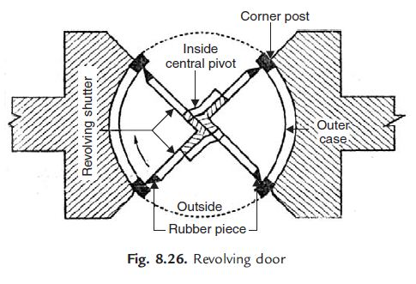
Revolving doors
Consist of centrally placed mullion or pivot in circular opening
Revolving leaves are radially attached to pivot
Shutters are glazed,fullu panelled or partly glazed or partly glazed
Central pivot is ball bearing
At the rubbing ends vertical rubber pieces are provided
It is useful for buildings with heavy rush.

Slide 31
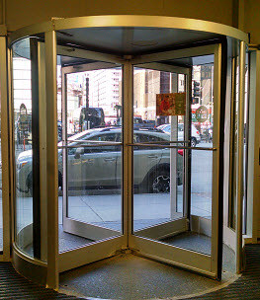

Slide 32
Rolling steel doors

Slide 33
It consist of frame,drum,shutter of thin plates(thickness=1mm)
Grooves of 25mm thickness left in frame
Diameter of drum= 200mm to 300mm
Provided for garages,show rooms,shops,godowns,factories etc.

Slide 34
Sliding doors

Slide 35
Shutters with one or several leaves slide either
Doesnot cause obstruction during movement ,used in entrances of godowns,sheds,shops etc

Slide 36
Swing door
Special hinges with double action spring is provided
Door is closed in position when not in use.

